Slide 1
Servo Bot
Day 1 - Building robots to take over the library!

Slide 2
Objective - Day 1
Create an obstacle avoiding robot.
Equipment
1 - Arduino Nano with cable
1 - Chassis
2 - Wheels
2 - Continuous servos
1 - Infrared Sensor
2 - Power packs
1 - Mini-breadboard
A few jumper wires
Not quite a boatload, but a ridiculous amount of zip ties

Slide 3

Assembling the Robot

Slide 4
Live Demo

Slide 5
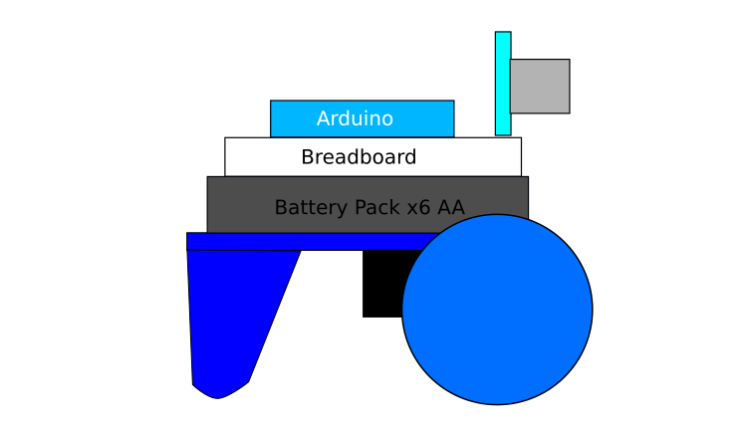
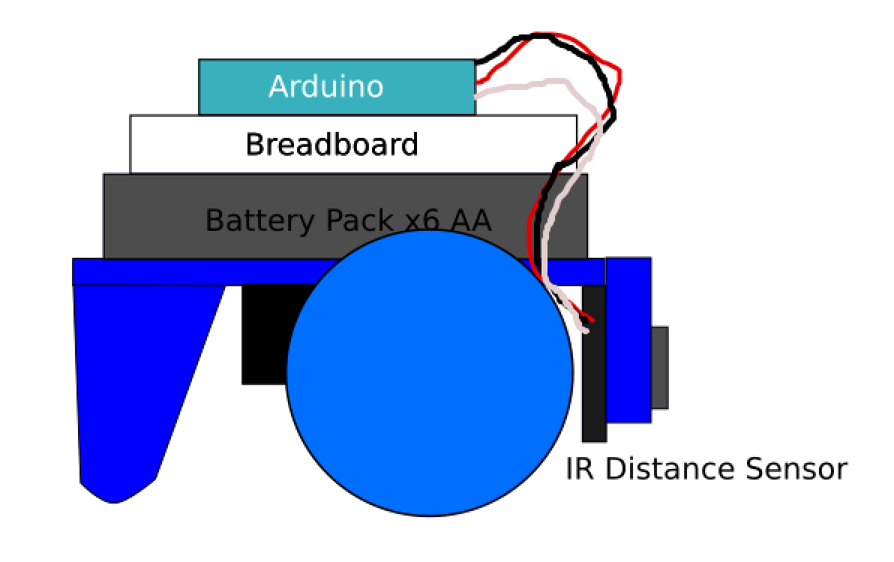
ServoBot
Design criteria
-2 wheels
-mounting points for servos
-balancing leg
-mounting point for electronics
-continous rotation servos
-bonus - inexpensive!

Slide 6
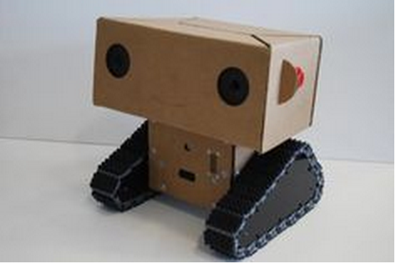
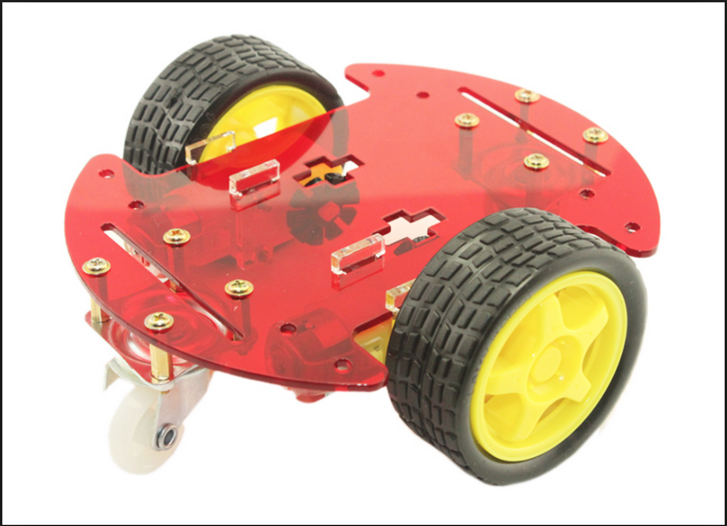
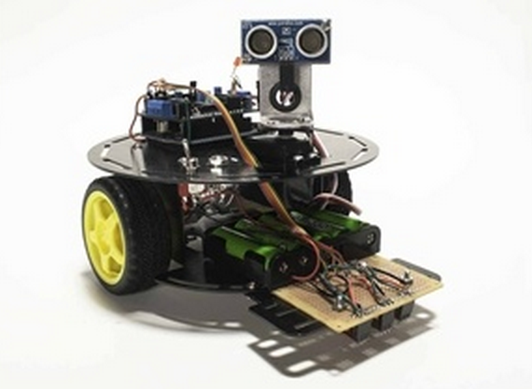
Chassis
Materials:
Carboard
Plastic
Sheet metal (sharp ouch!)
Fabrication:
3D printing
laser cutting

Slide 7
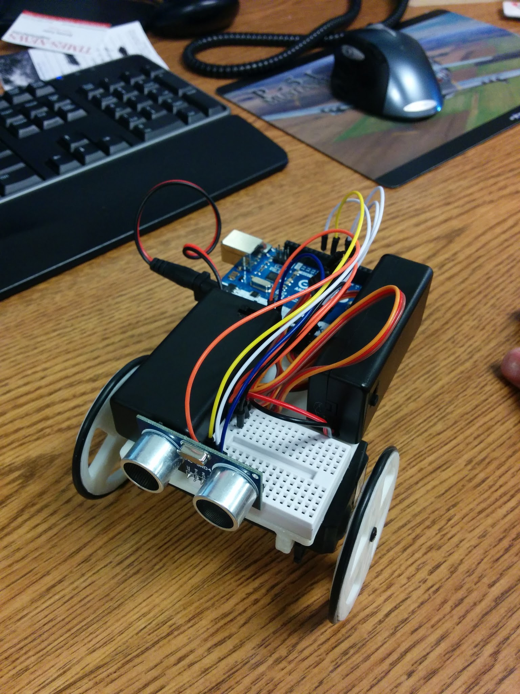
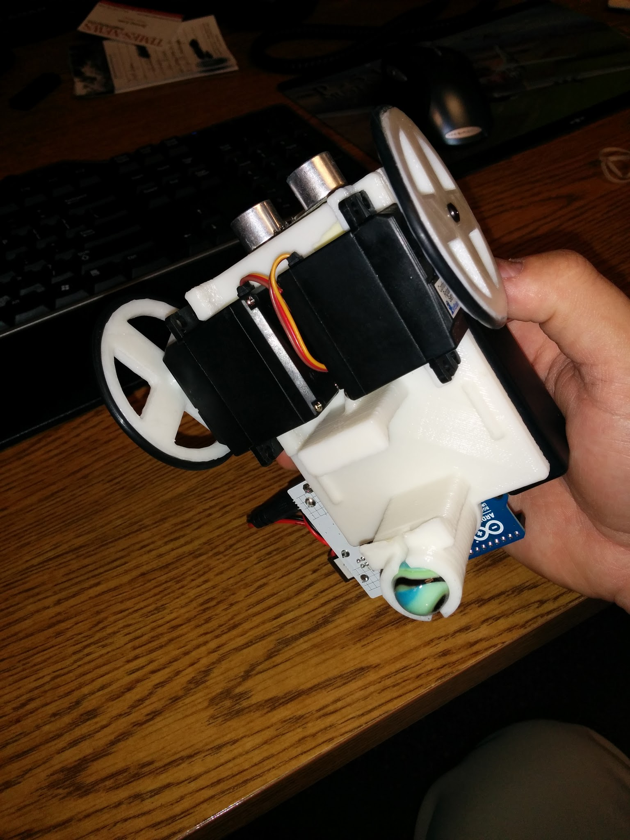
Design v1
3D printed chassis and wheels from thingiverse.com
Arduino Uno
Ultrasonic Sensor
2 Continuous Servos
2 x 9v battery packs
Jumper wires
O-rings
Breadboard
1 marble

Slide 8
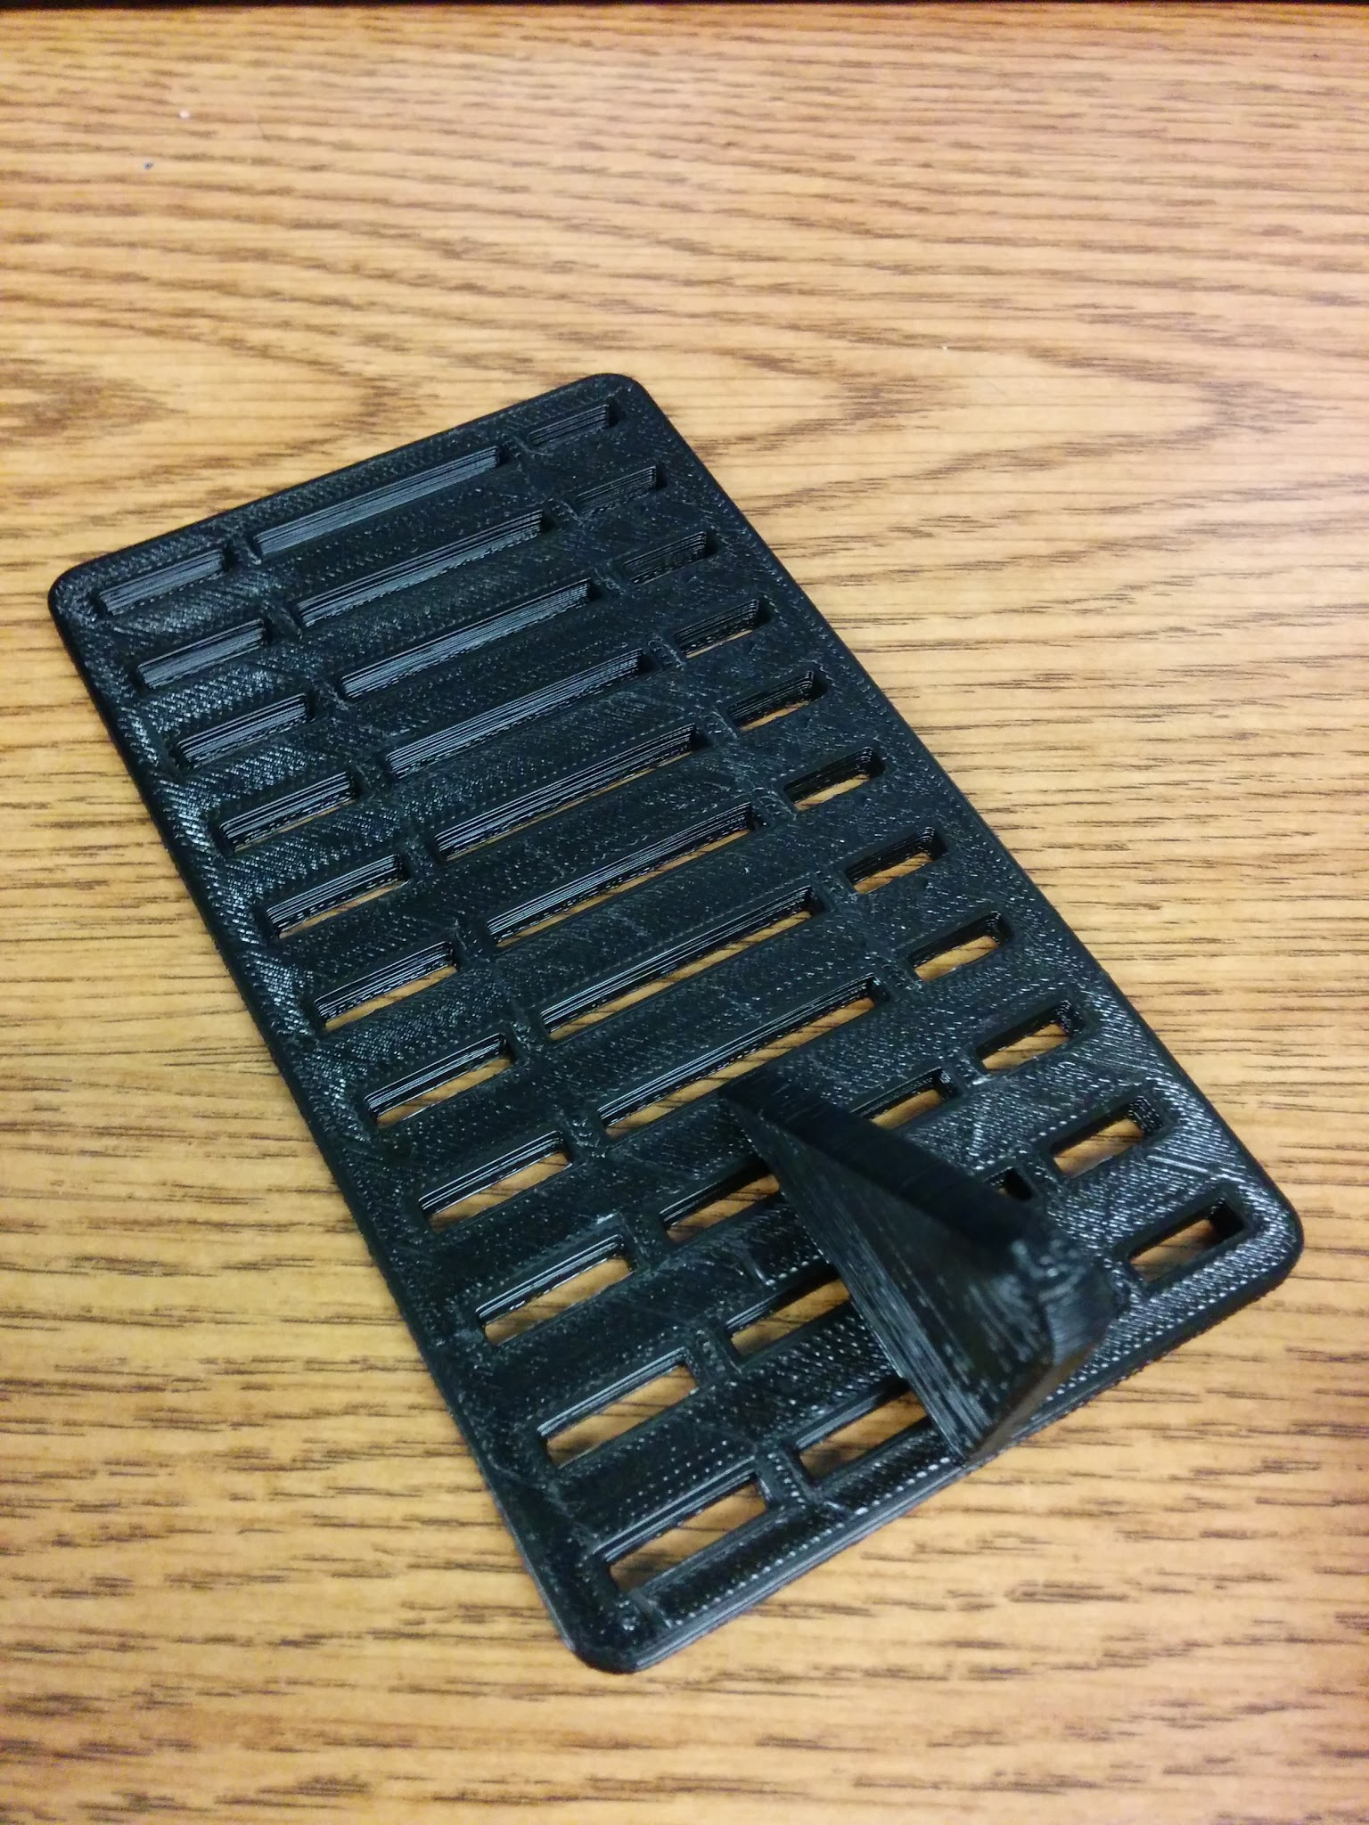
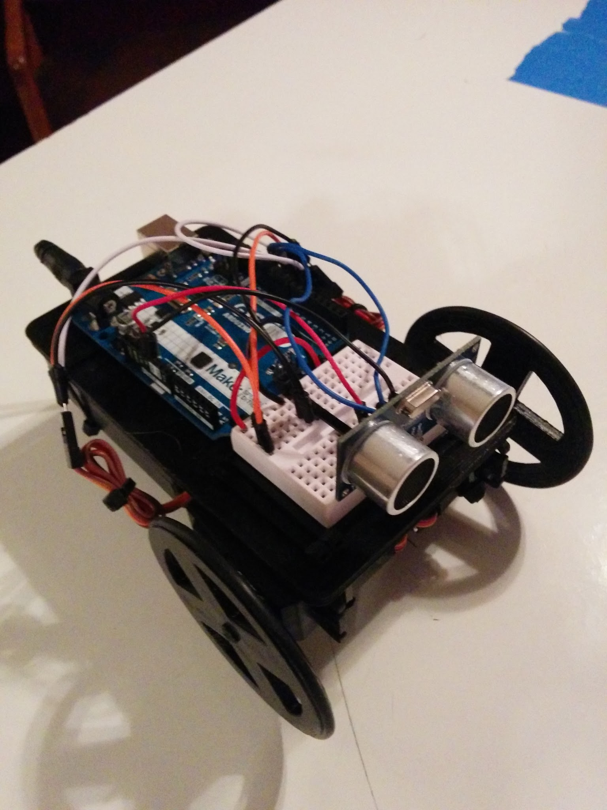
Design v2
Custom 3D printed chassis. Faster print time.
Wheels from thingiverse.com
Arduino Uno
2 Continuous Servos
Sonic Sensor
2 x 9v battery packs
Jumper wires
O-rings
Breadboard

Slide 9
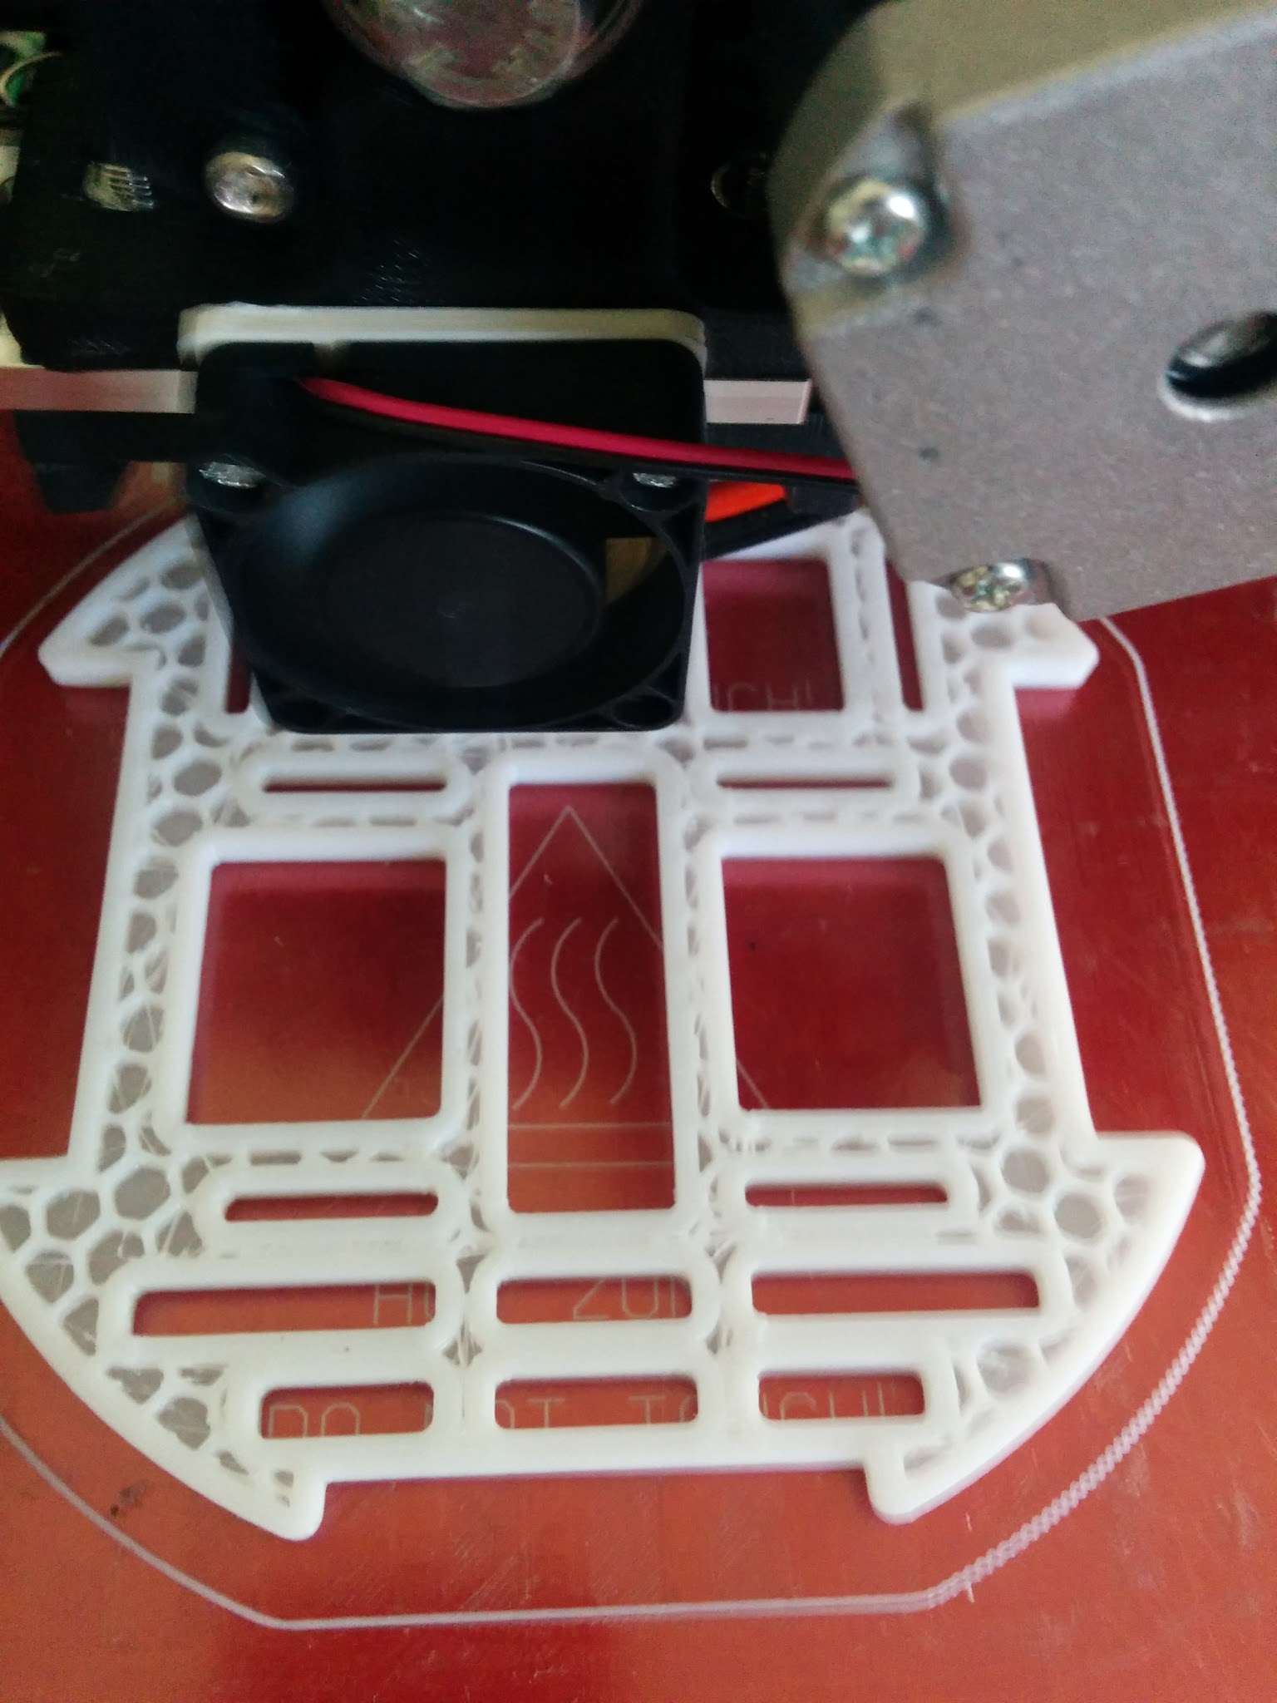
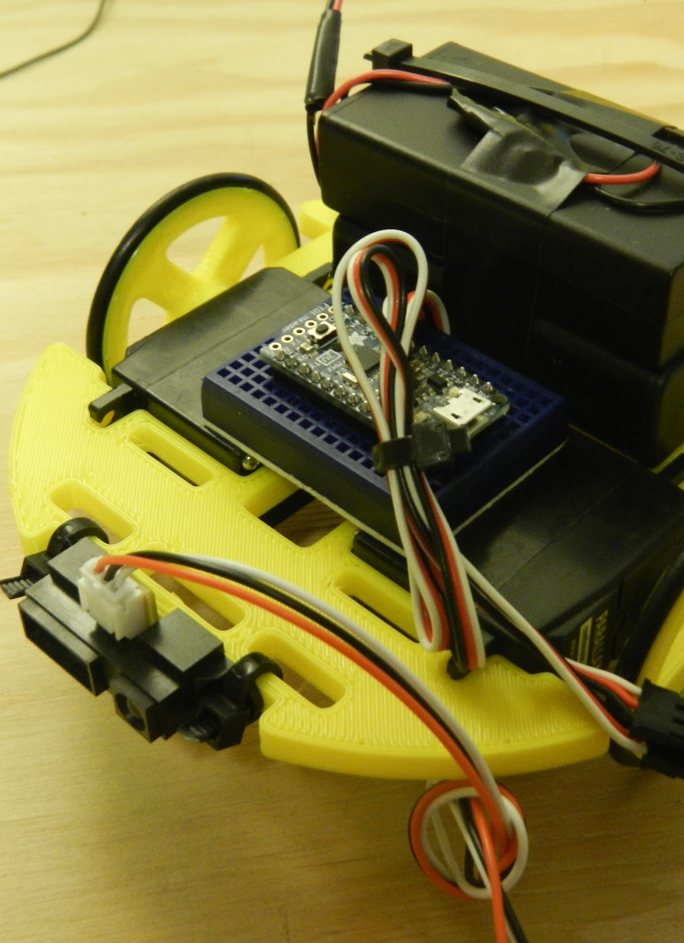
Design v3
Custom 3D printed chassis and wheels Faster print time. Frame prints within an hour.
Arduino Nano
IR sensor
2 Continuous Servos
Two 3xAA battery packs
Jumper wires
O-rings
Breadboard

Slide 10
Build your ServoBot

Slide 11
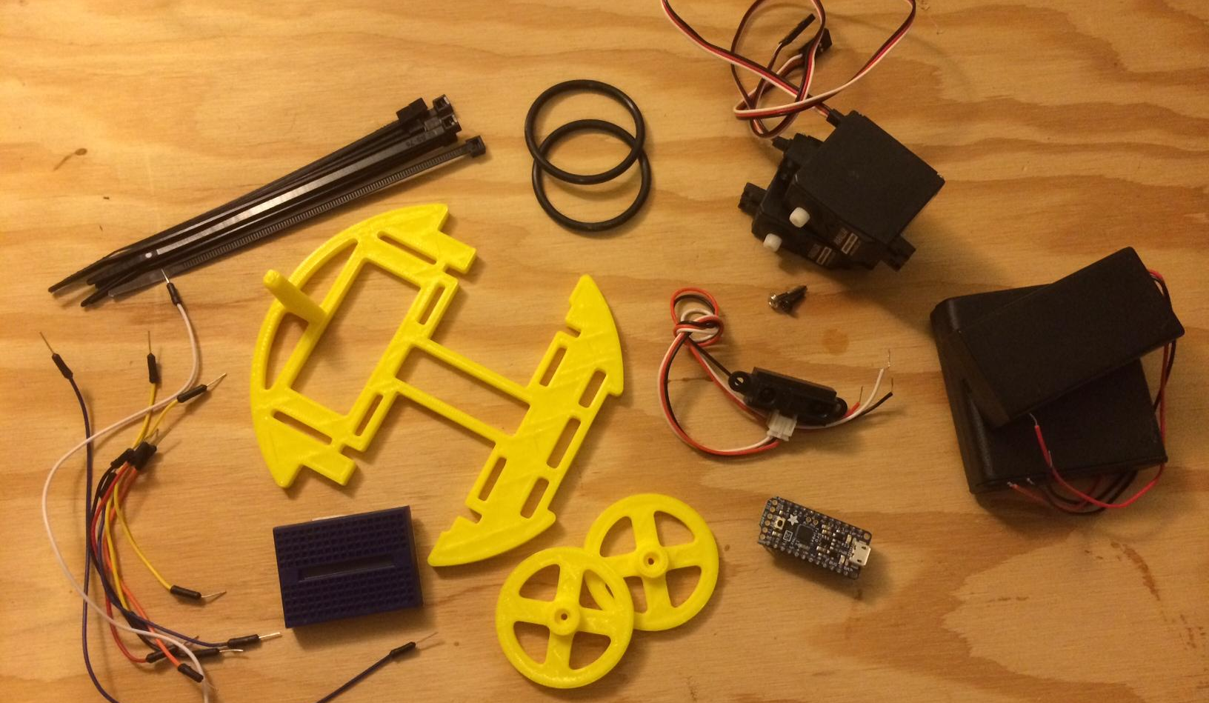
Materials List
o-rings
servo motors
zip ties
battery packs
ir sensor
chassis
jumper wires
Arduino
breadboard
wheel

Slide 12
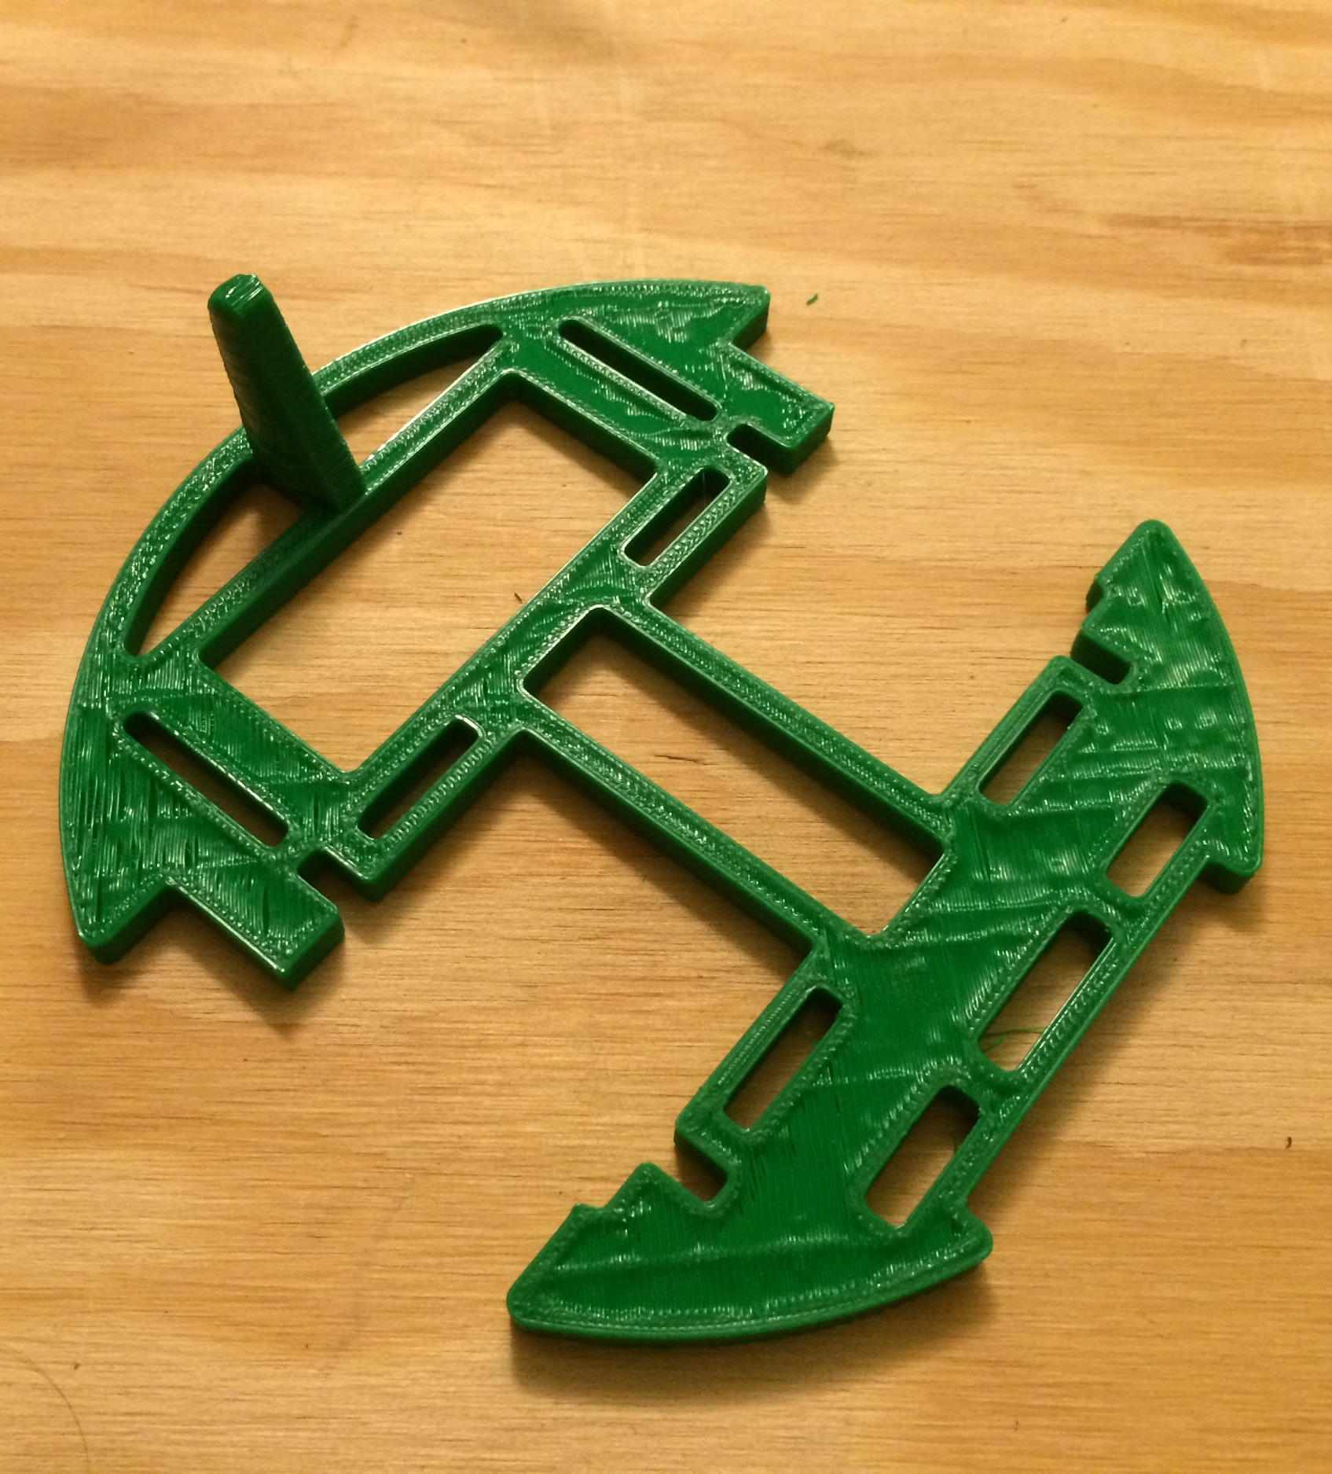
3D Printed Chassis
-Everything mounts to the chassis.
-3D printed, designed in CAD.
-Prints in under 60 min.
-Servos snap into place.

Slide 13
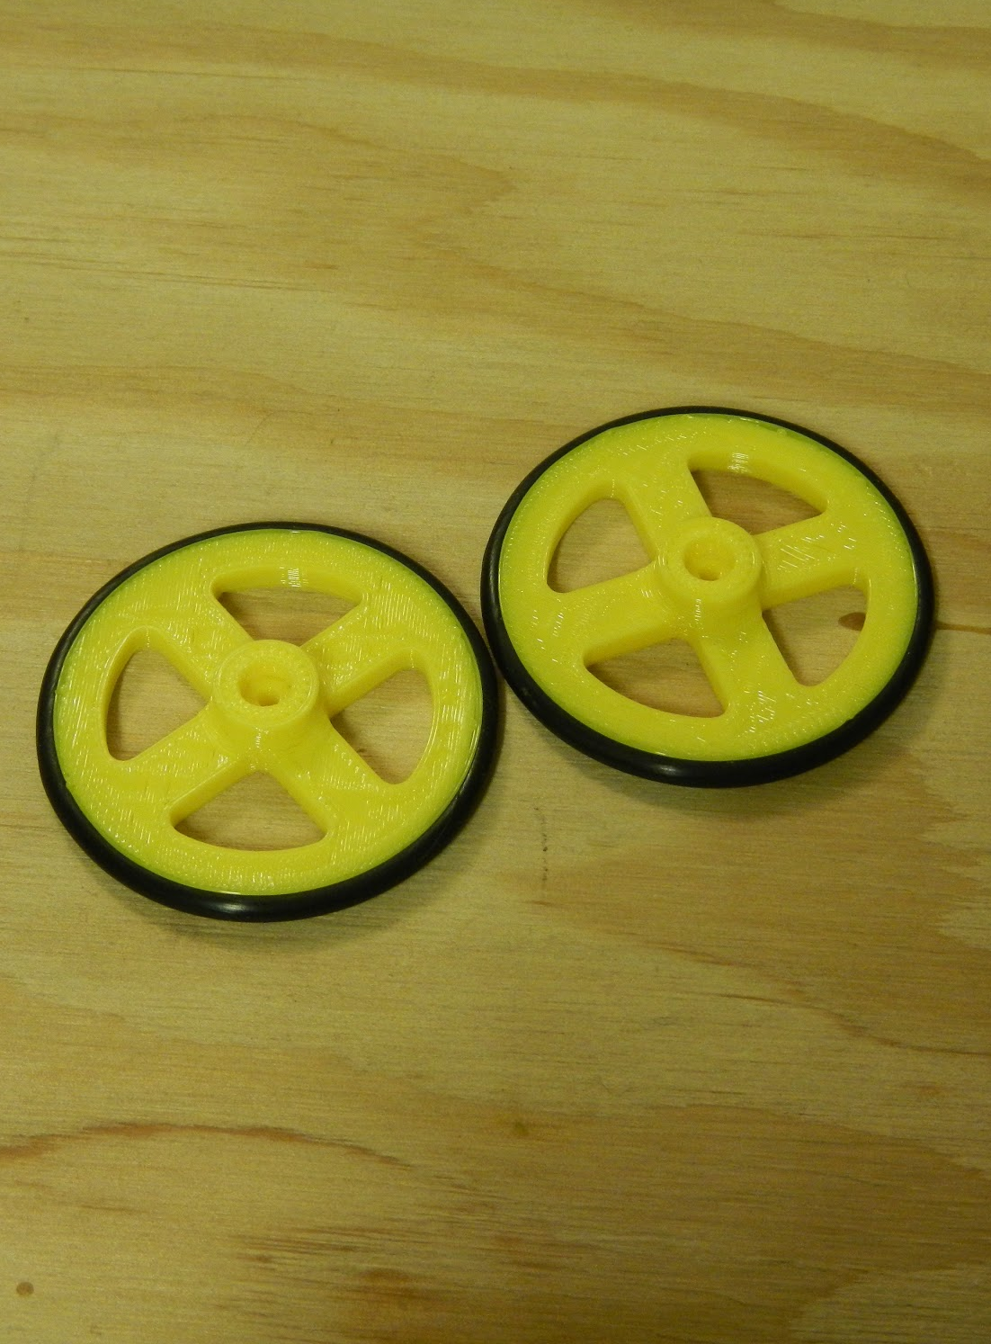
3D Printed Wheels
-Mounts to the servo horn.
-Holes in the middle for screw.
-Use o-rings as tires.
-Helps with traction.
-Cheap and effective!!!

Slide 14
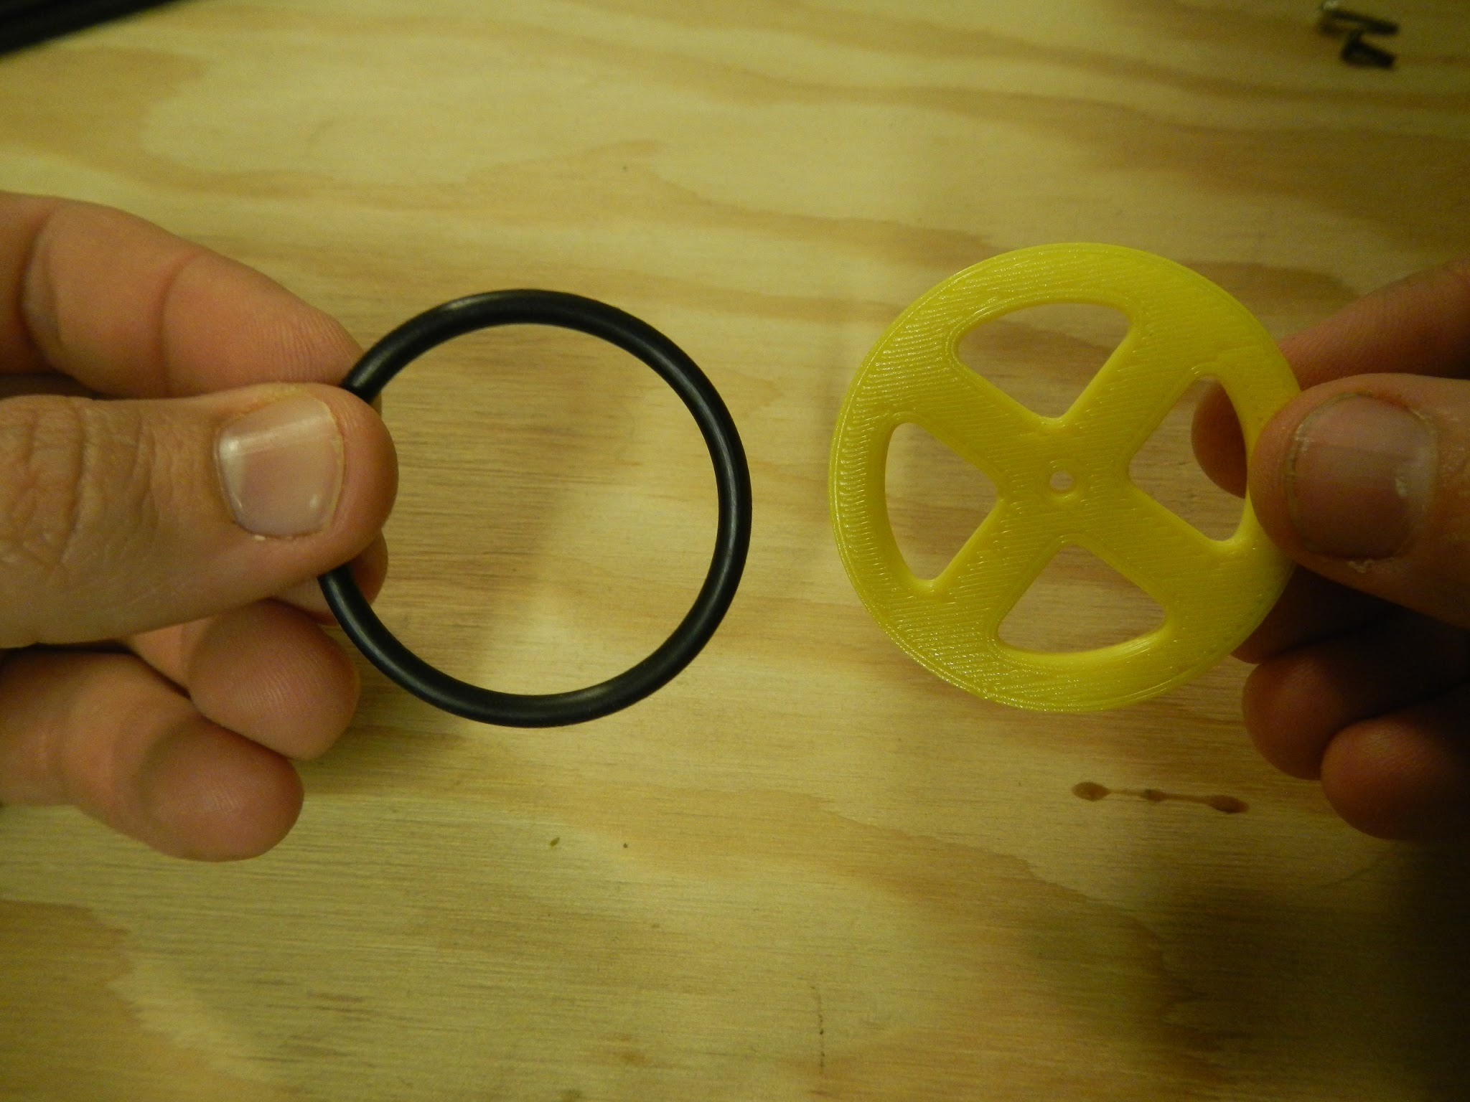
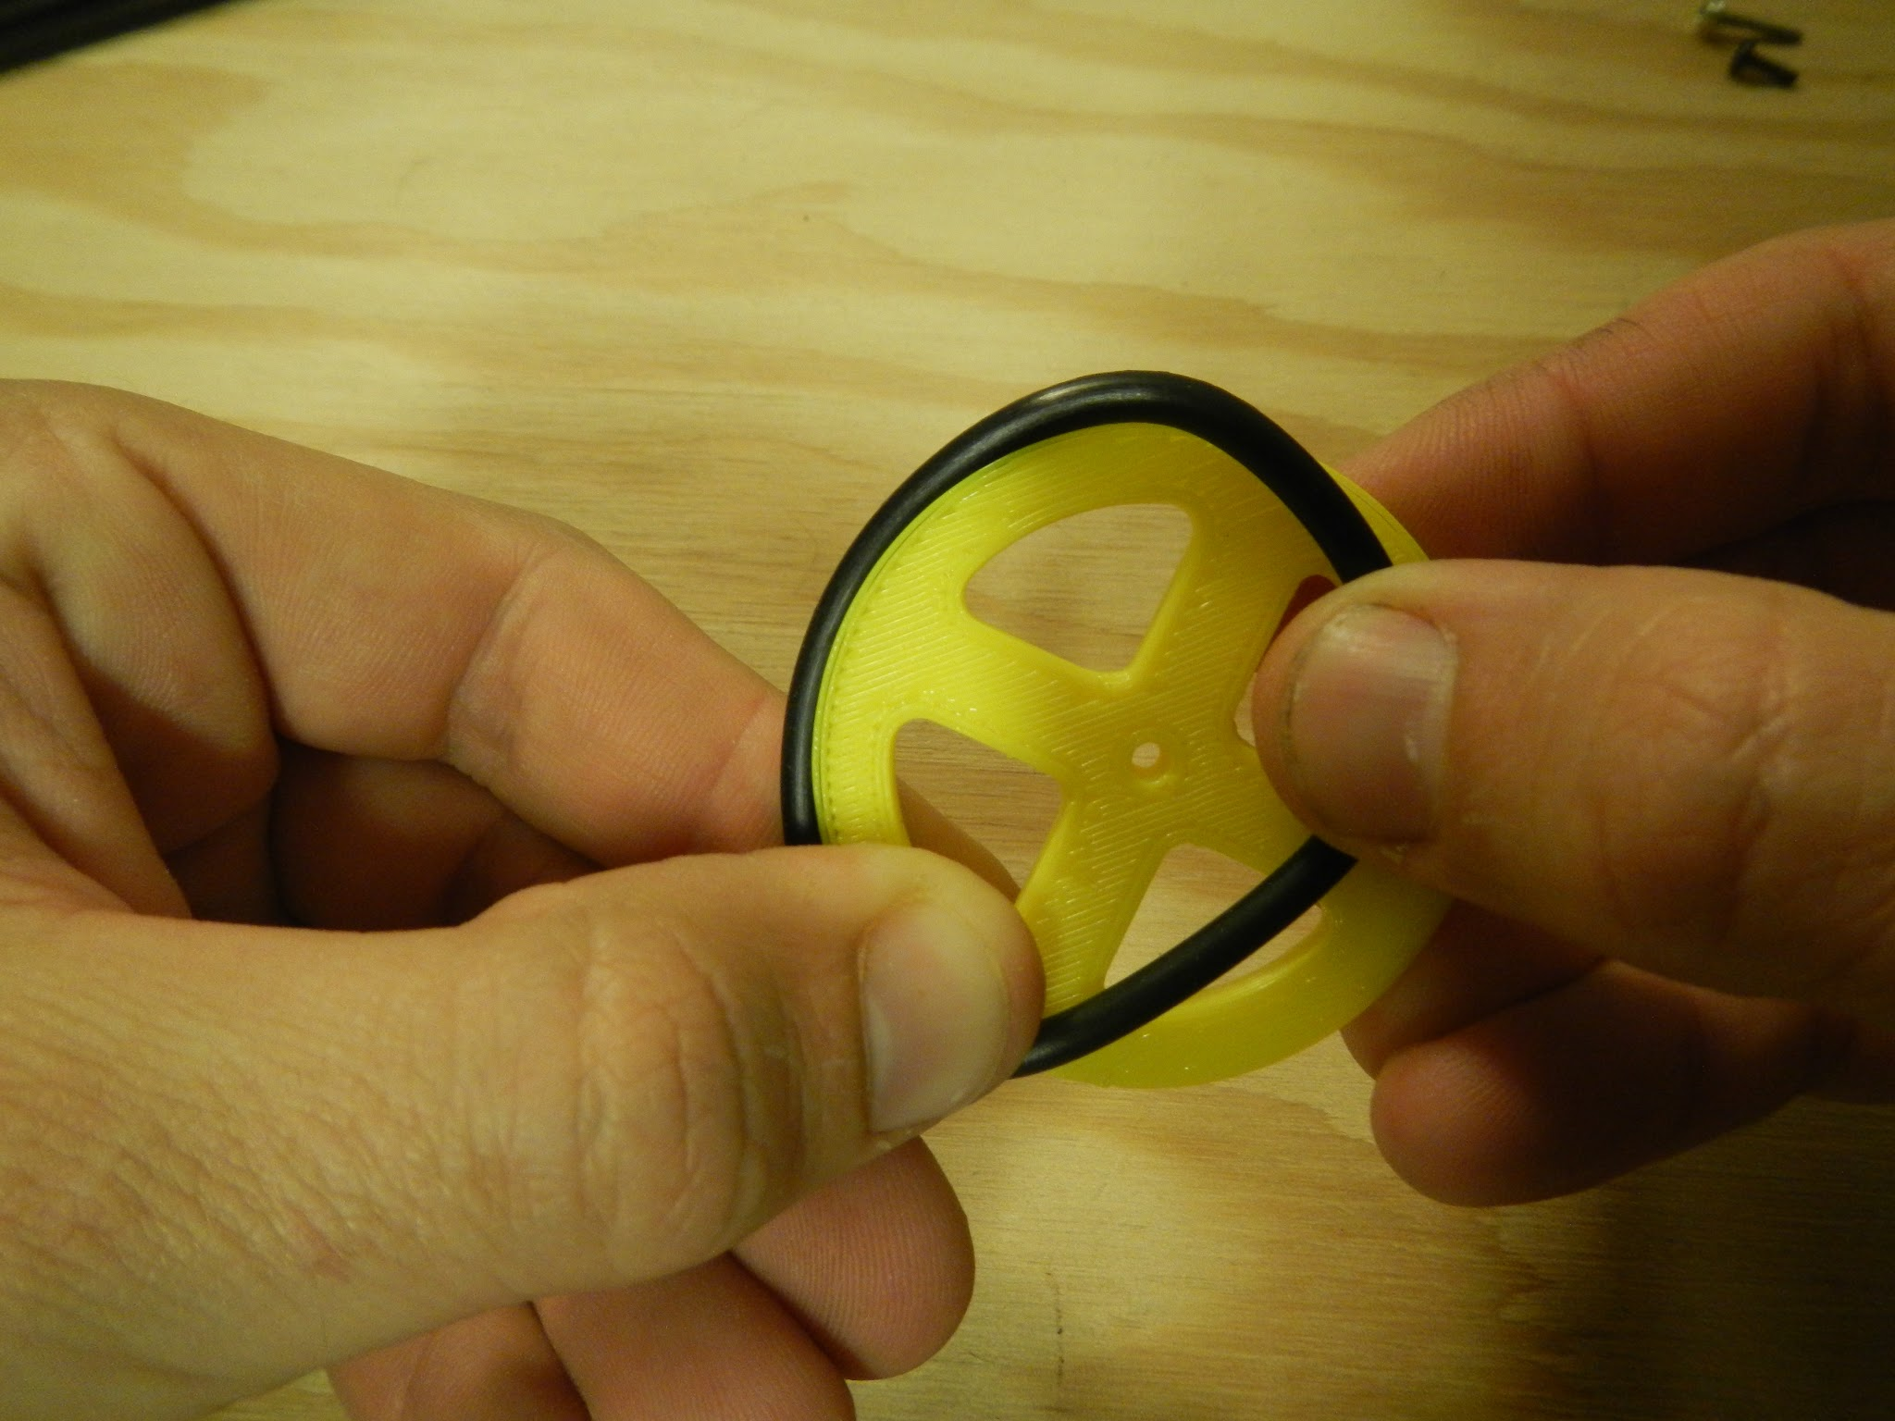
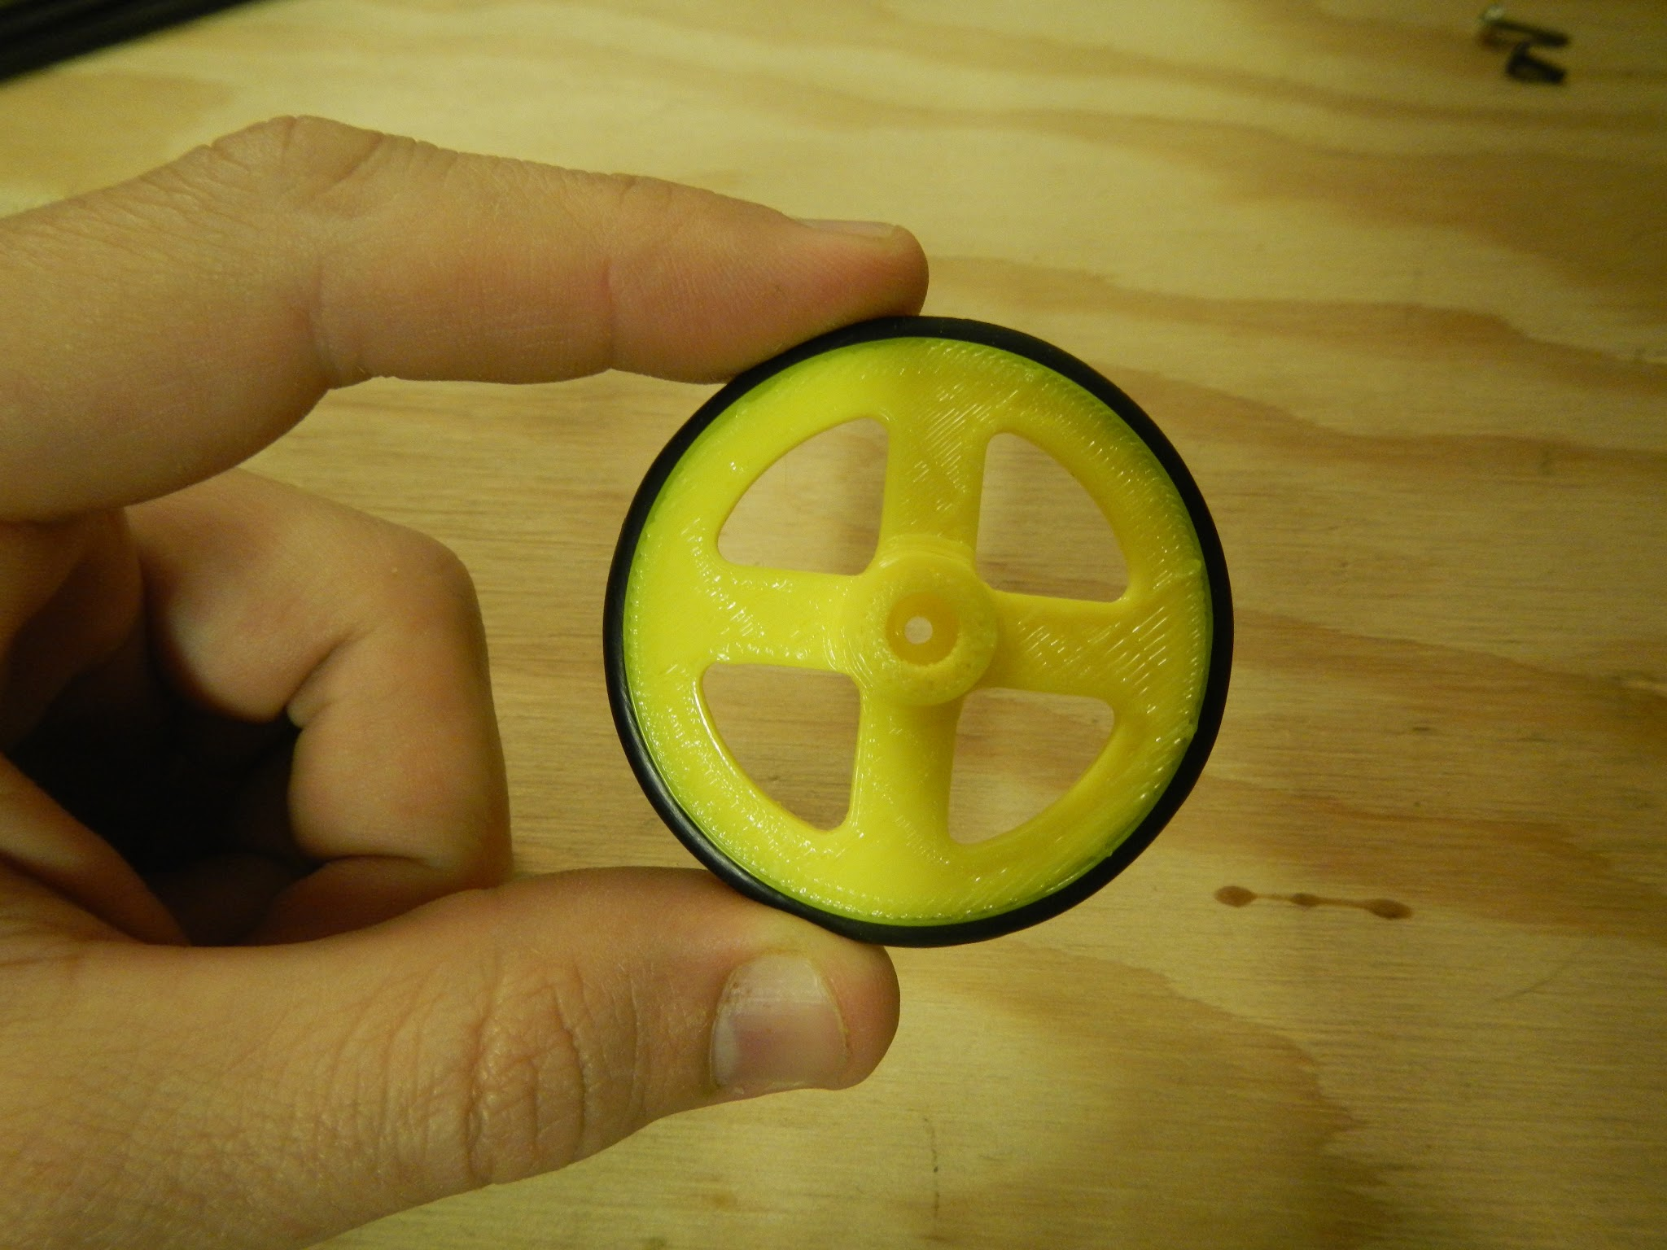
Wheels
Step 1
Step 2
Step 3

Slide 15
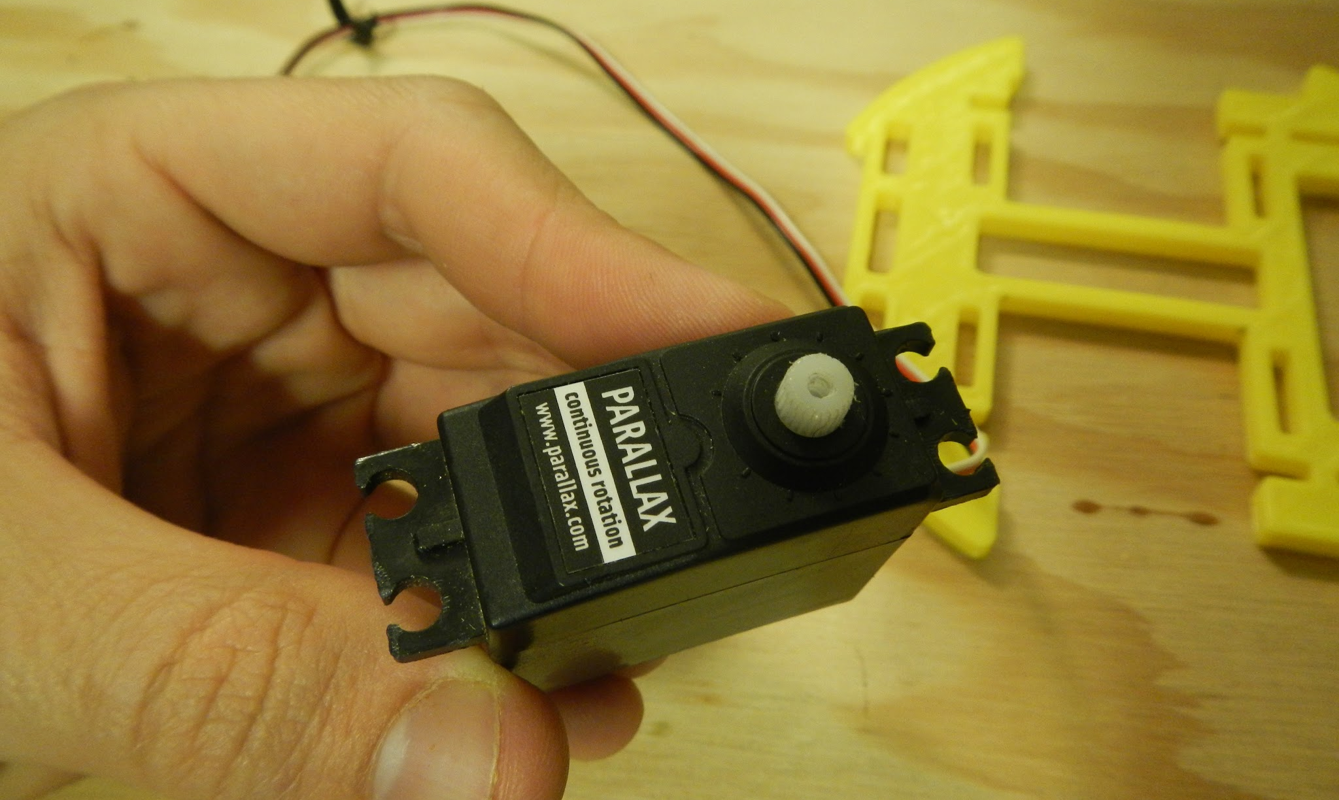
Servos

Slide 16
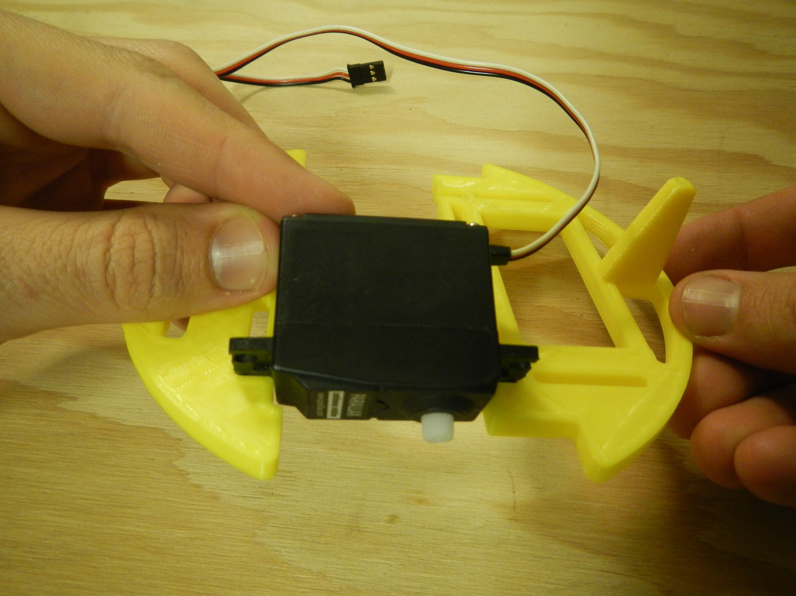
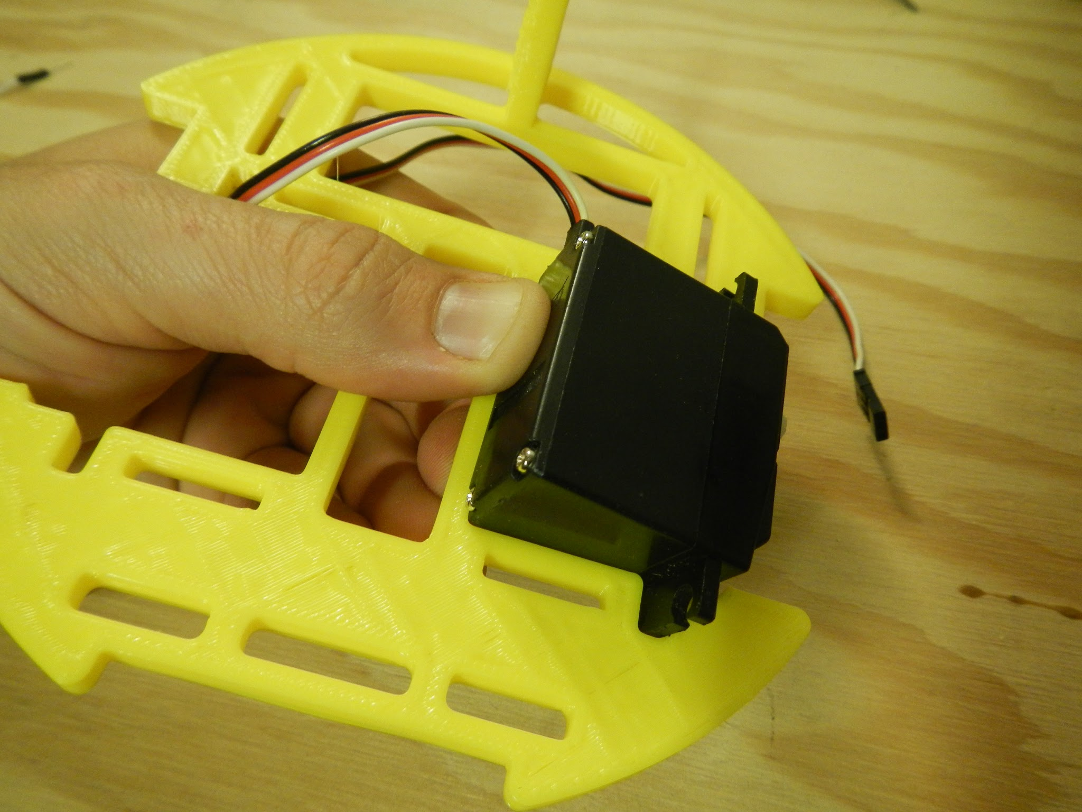
Install servo

Slide 17
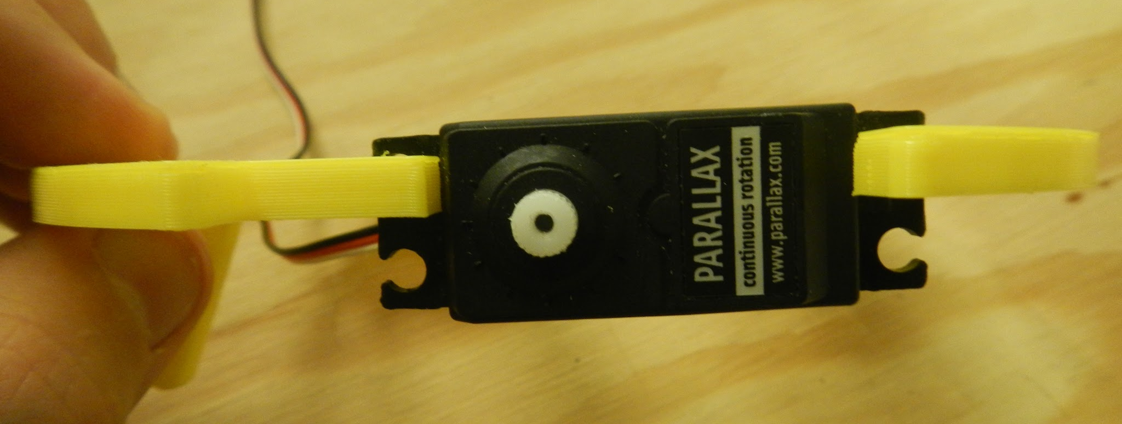
Install first servo

Slide 18
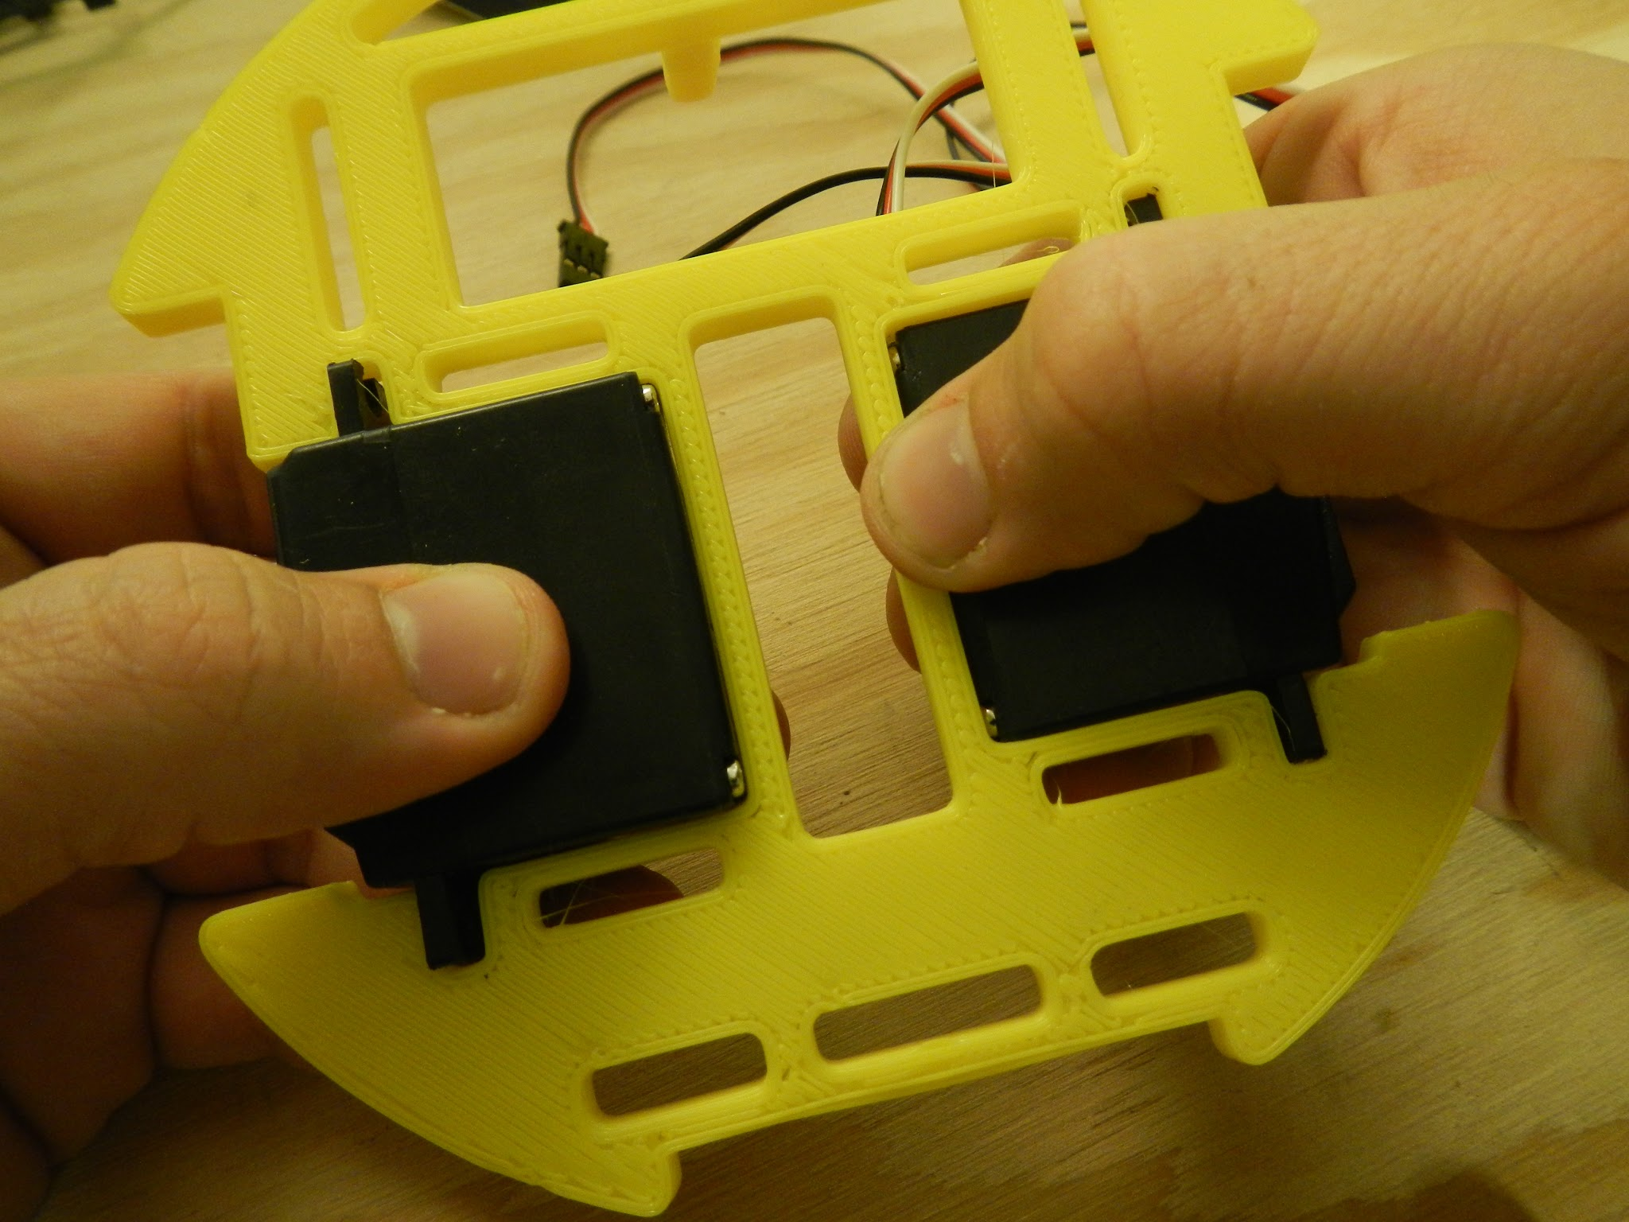
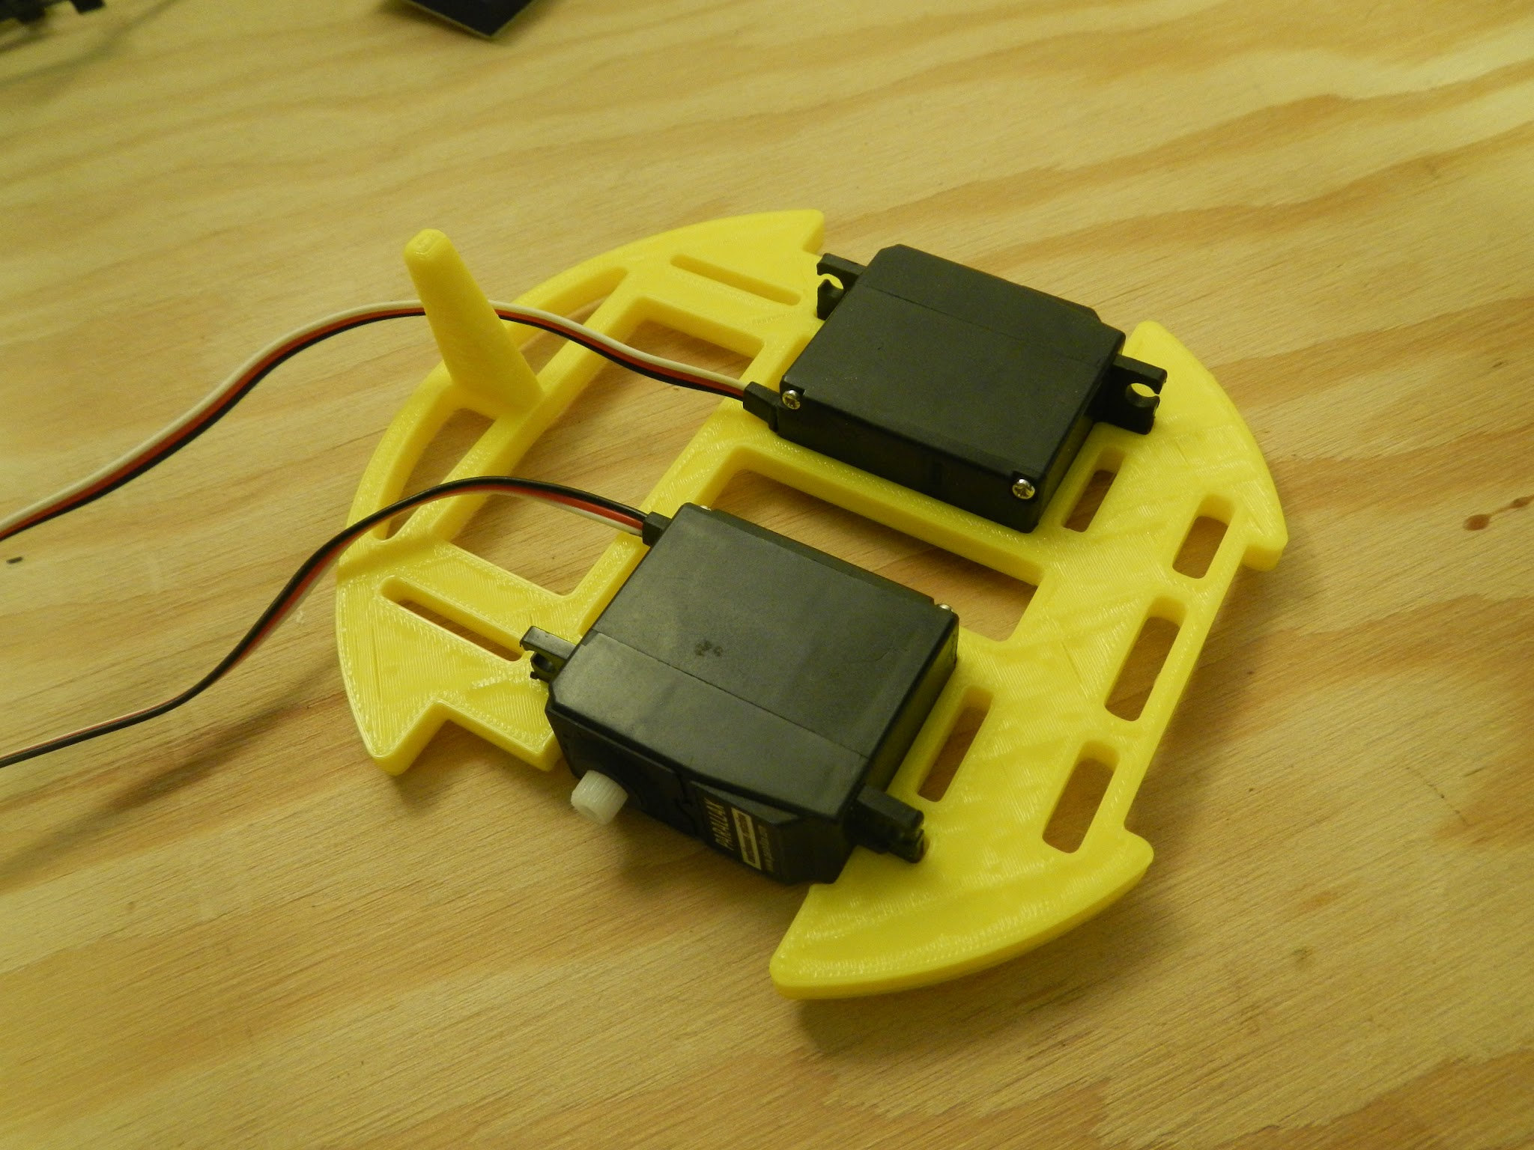
Install second servo

Slide 19
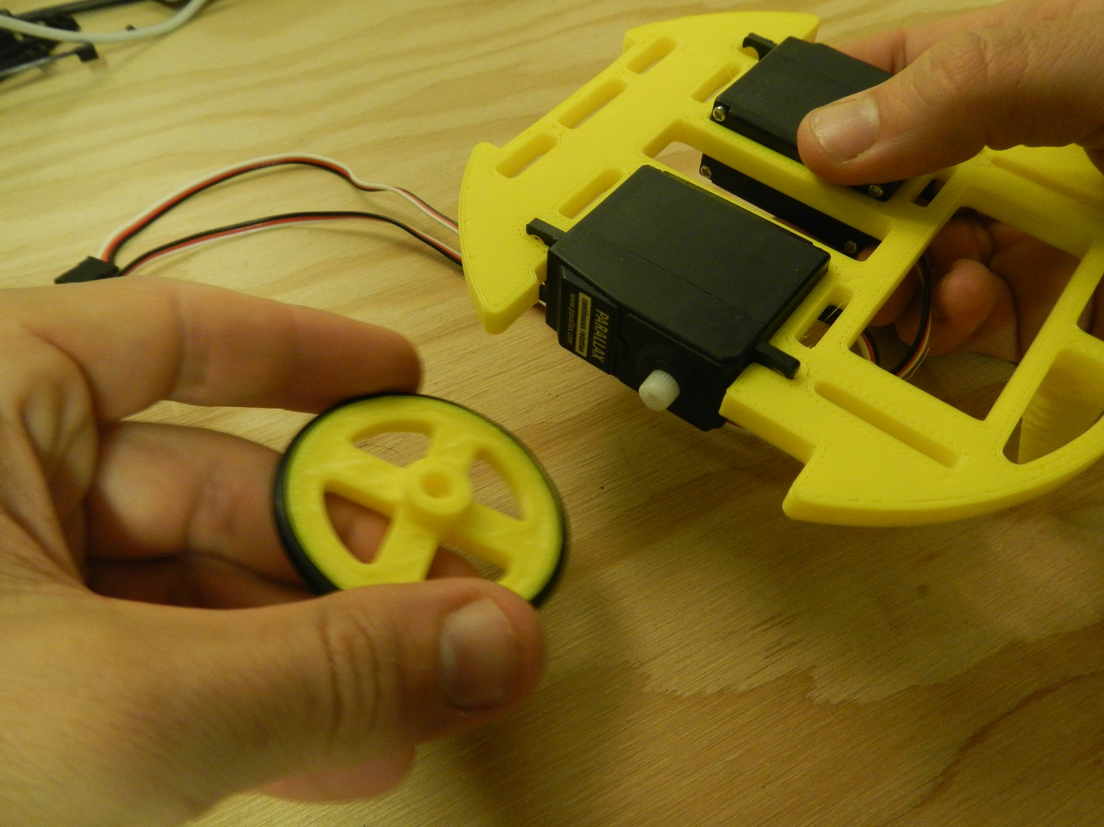
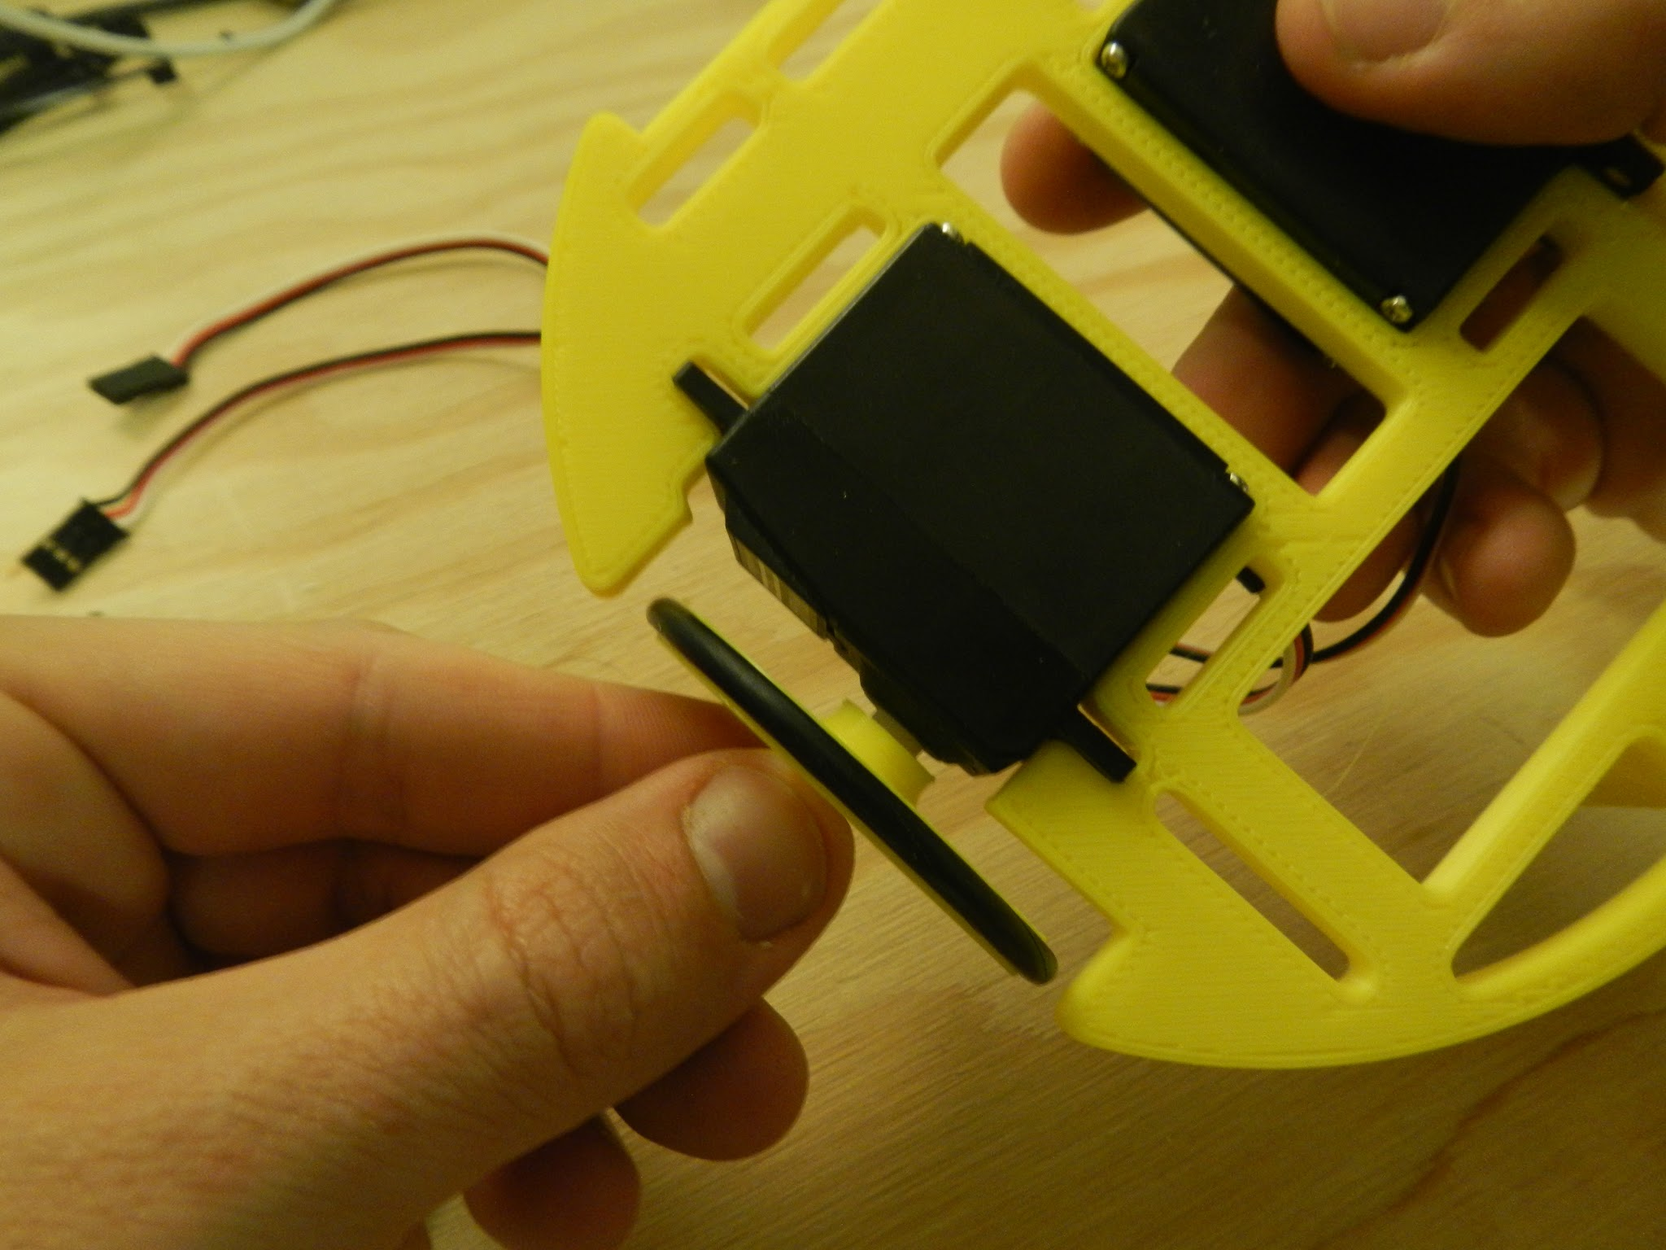
Install wheels

Slide 20
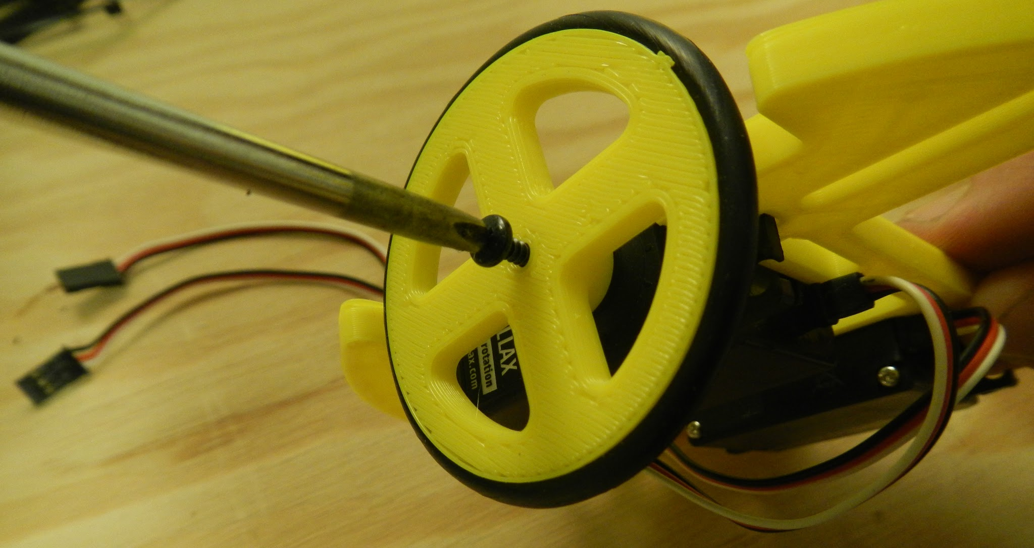
Install wheels

Slide 21
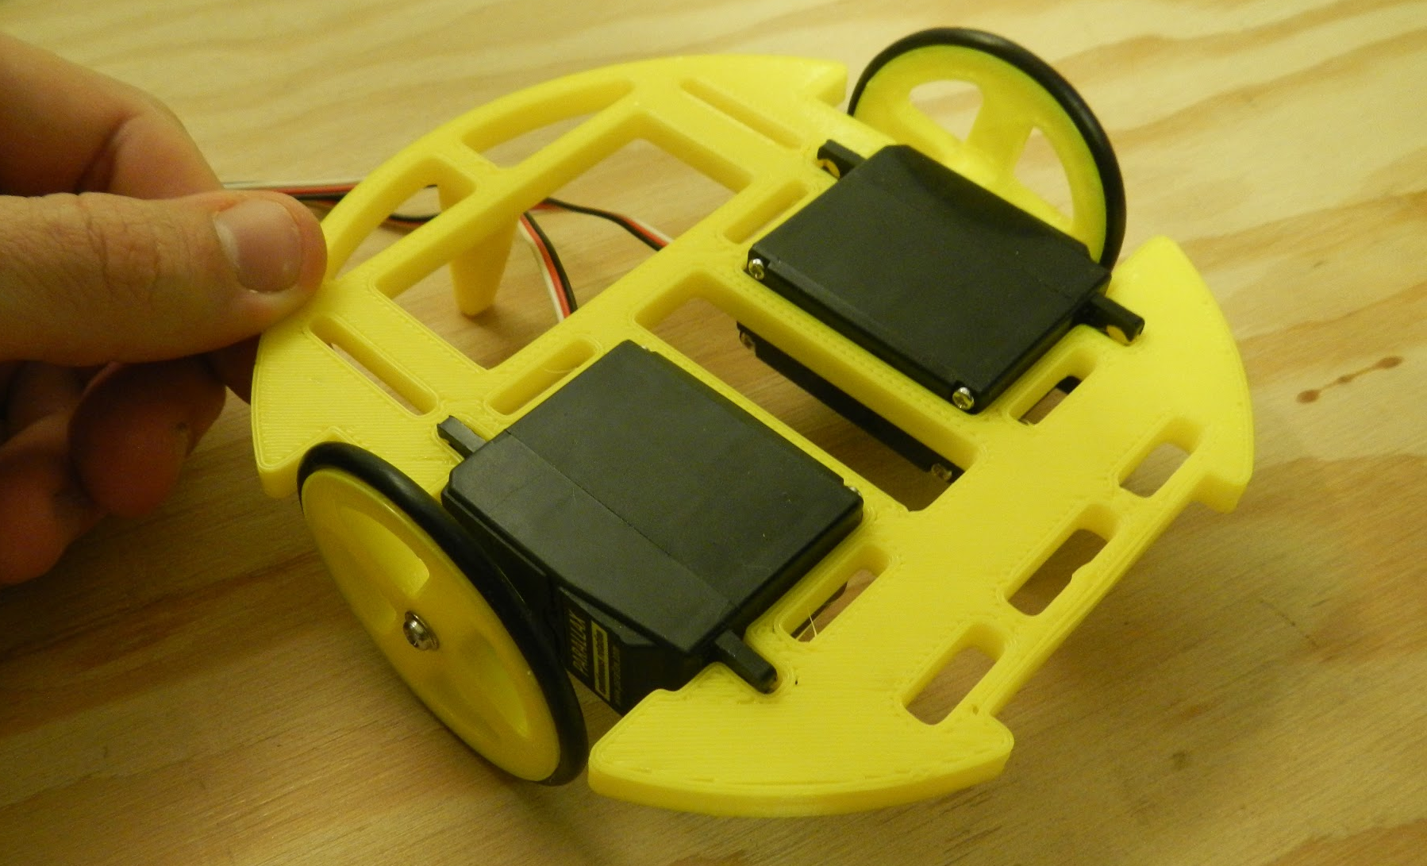
Rolling chassis

Slide 22
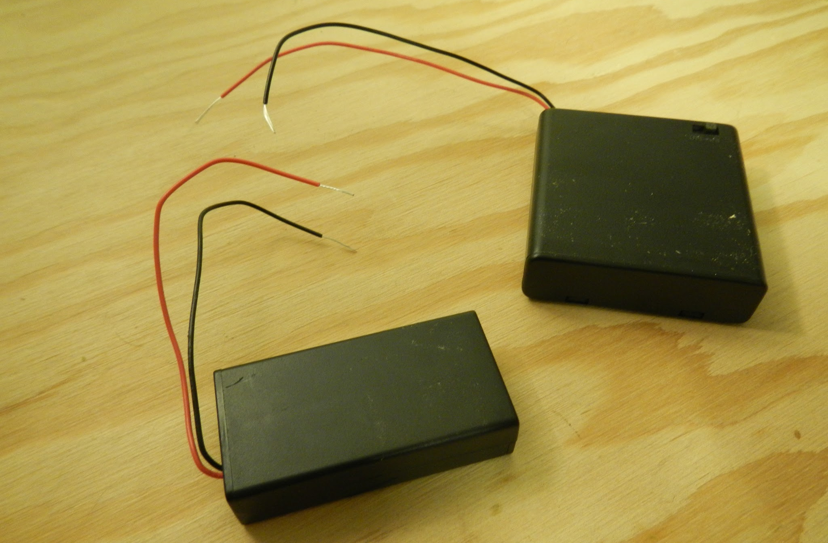
Build a bigger battery pack - 9V

Slide 23
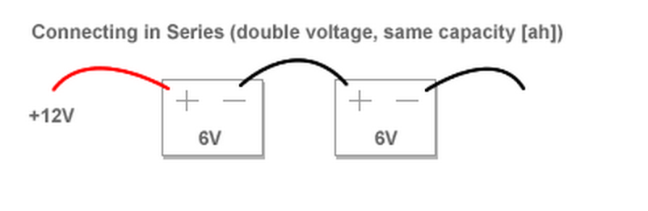
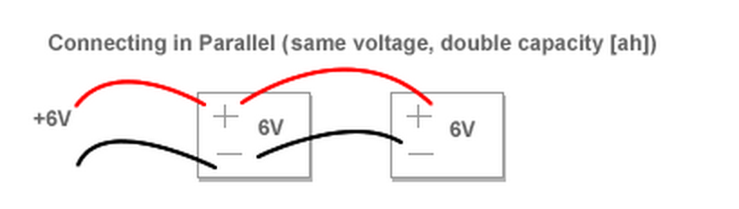
Build a bigger battery - wiring

Slide 24
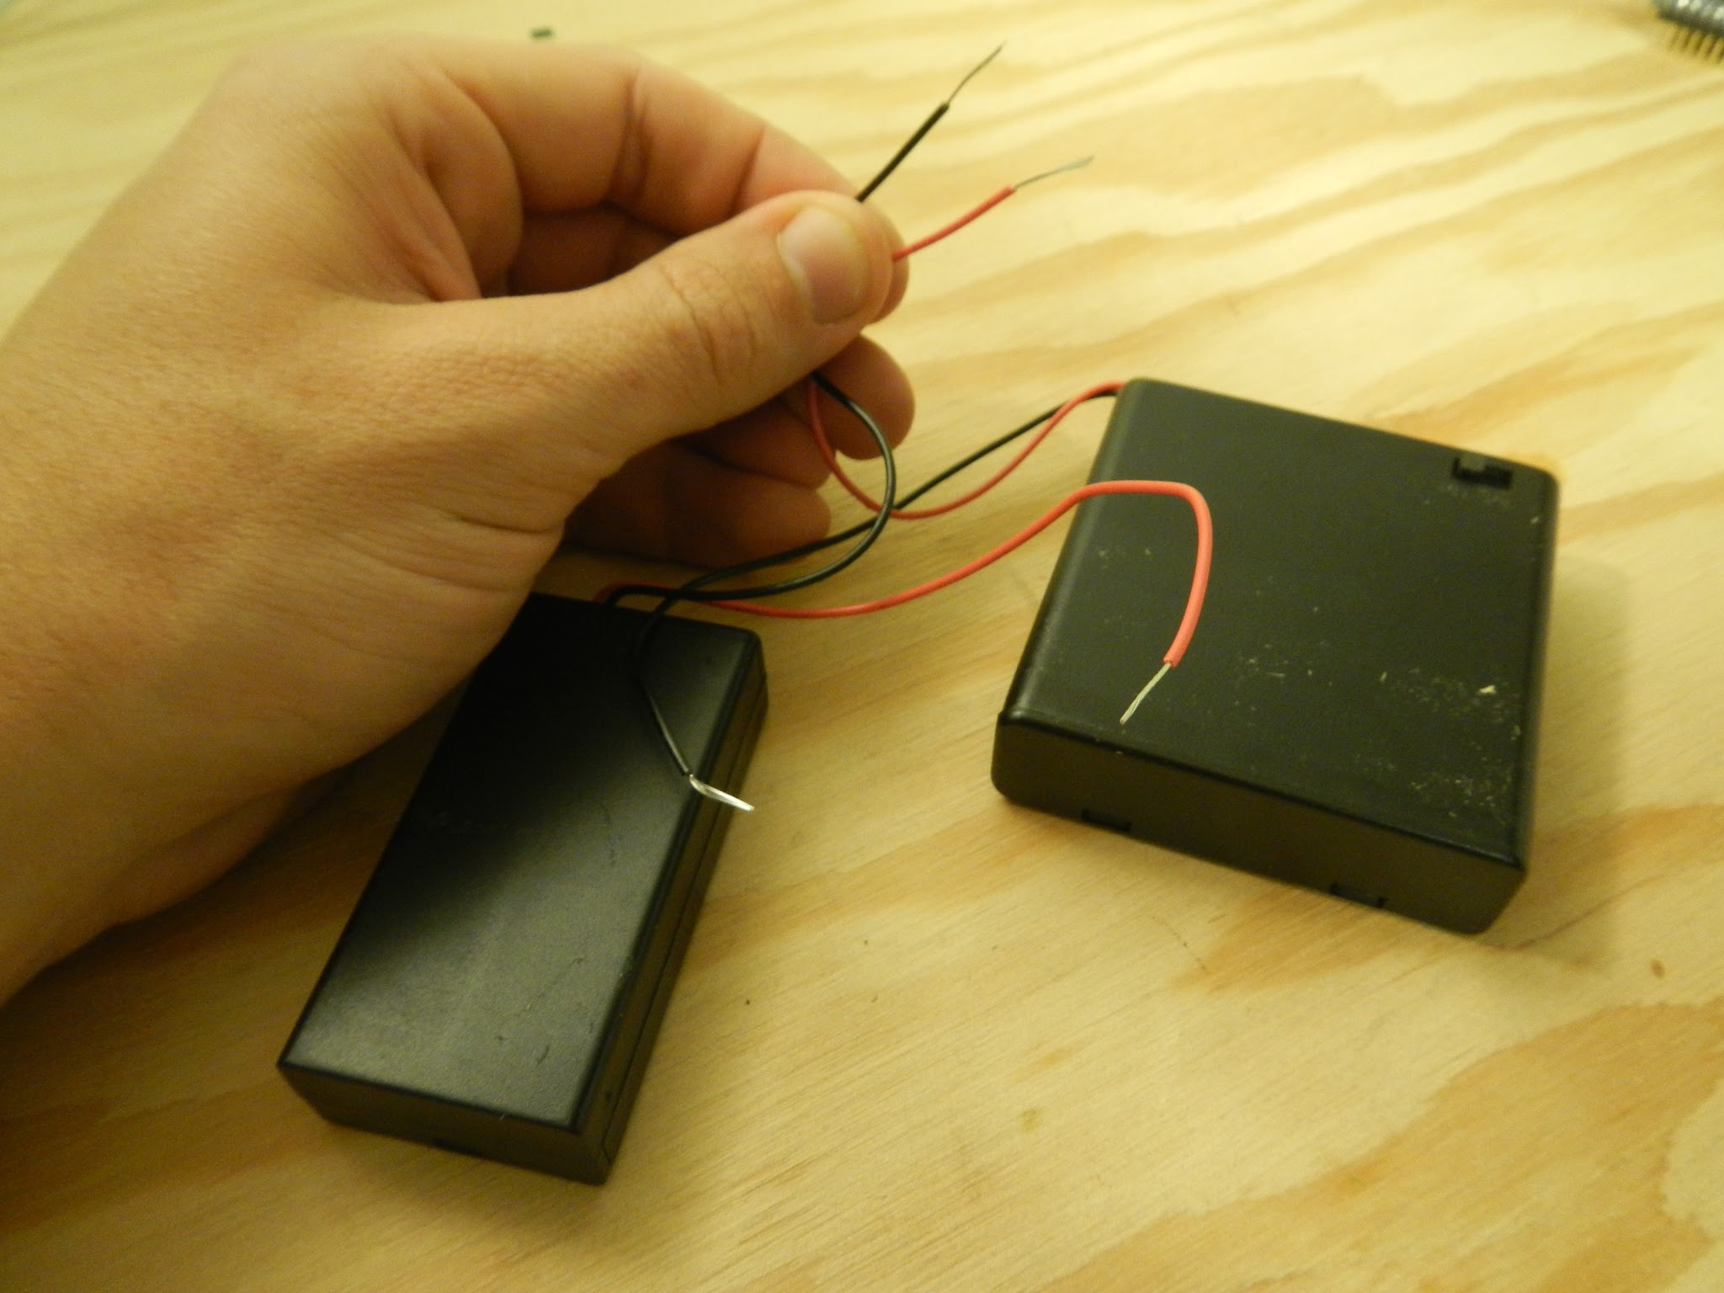
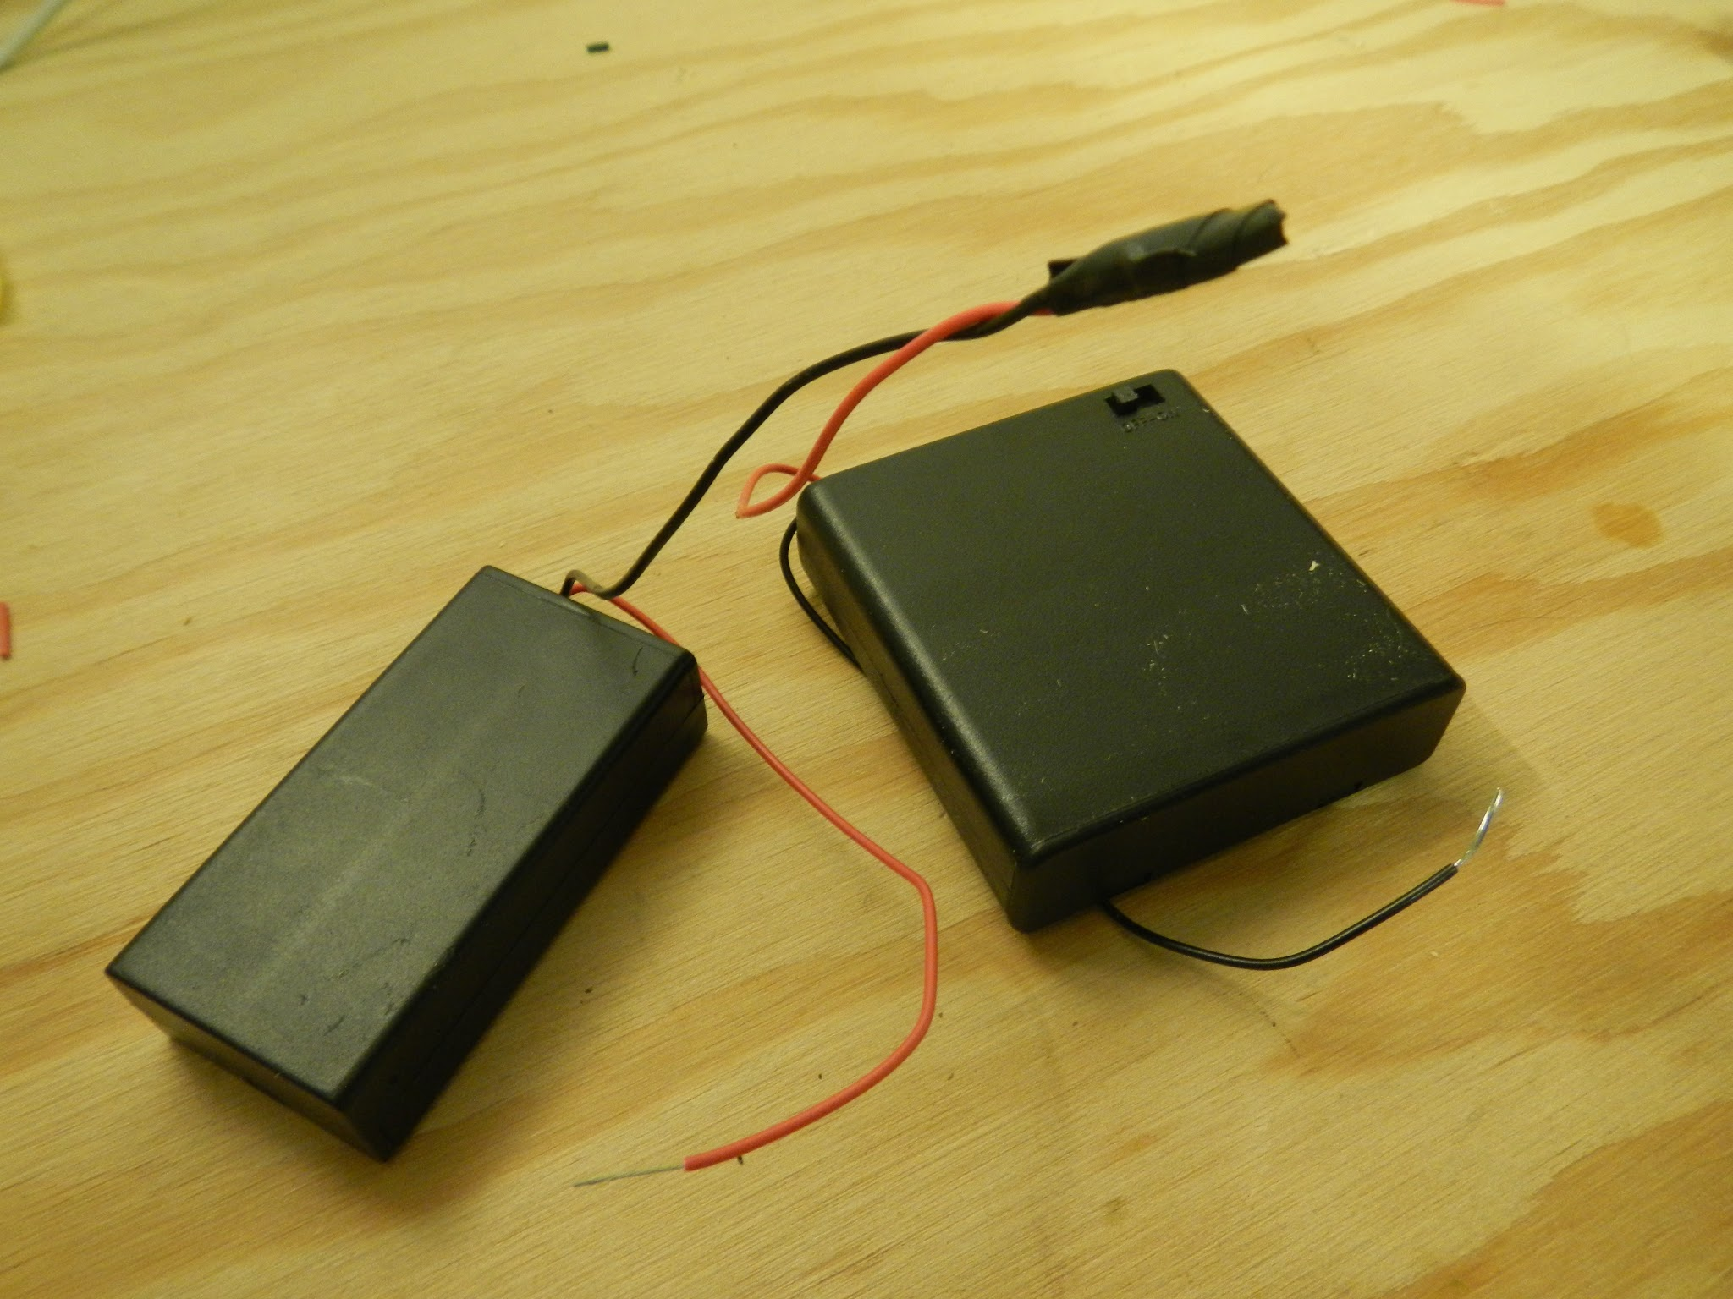
Build a bigger battery pack - 9V

Slide 25
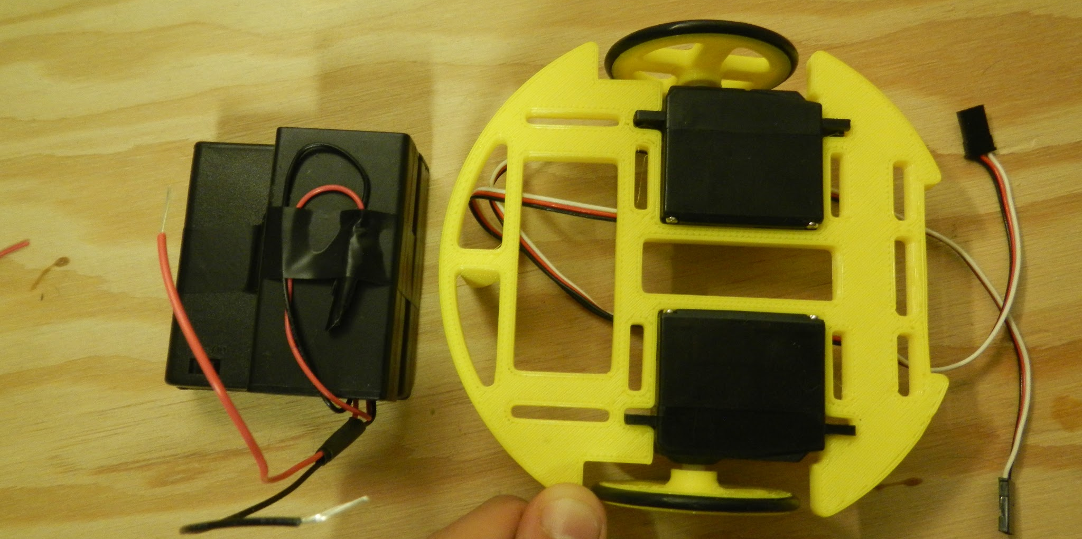
Mounting battery packs

Slide 26
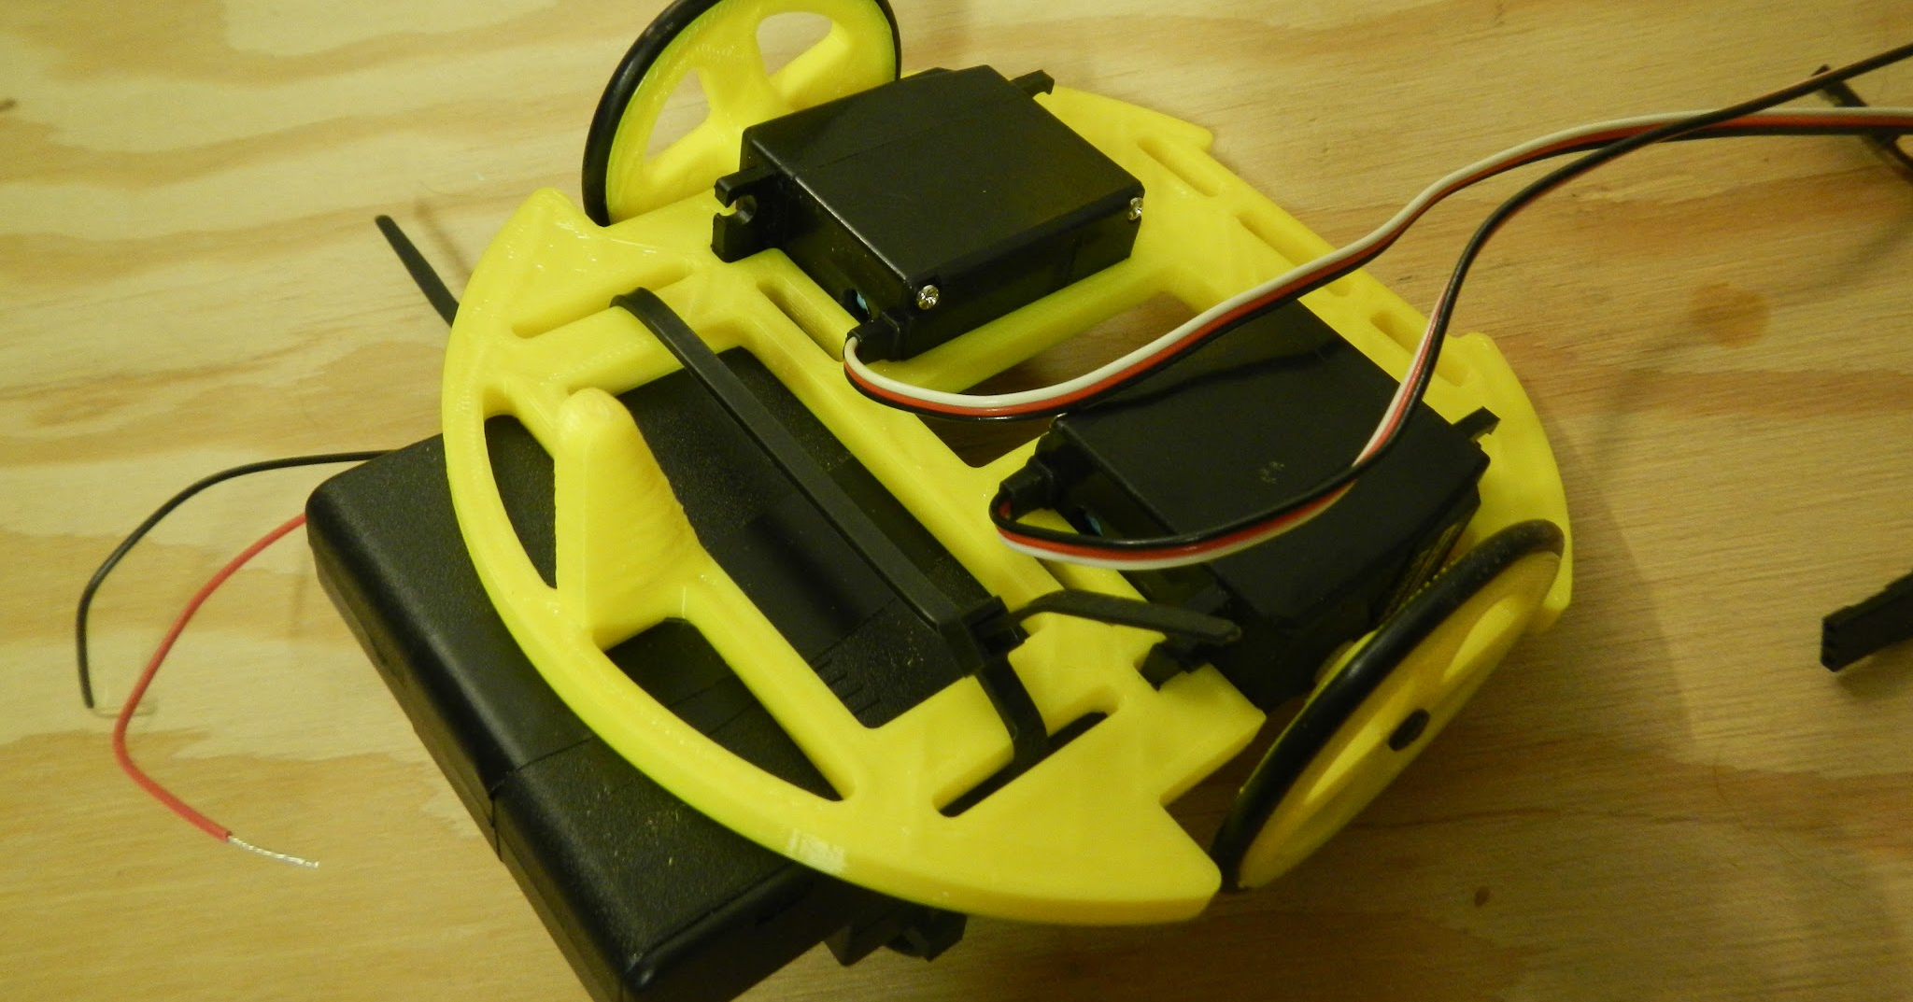
Battery pack + zip ties

Slide 27
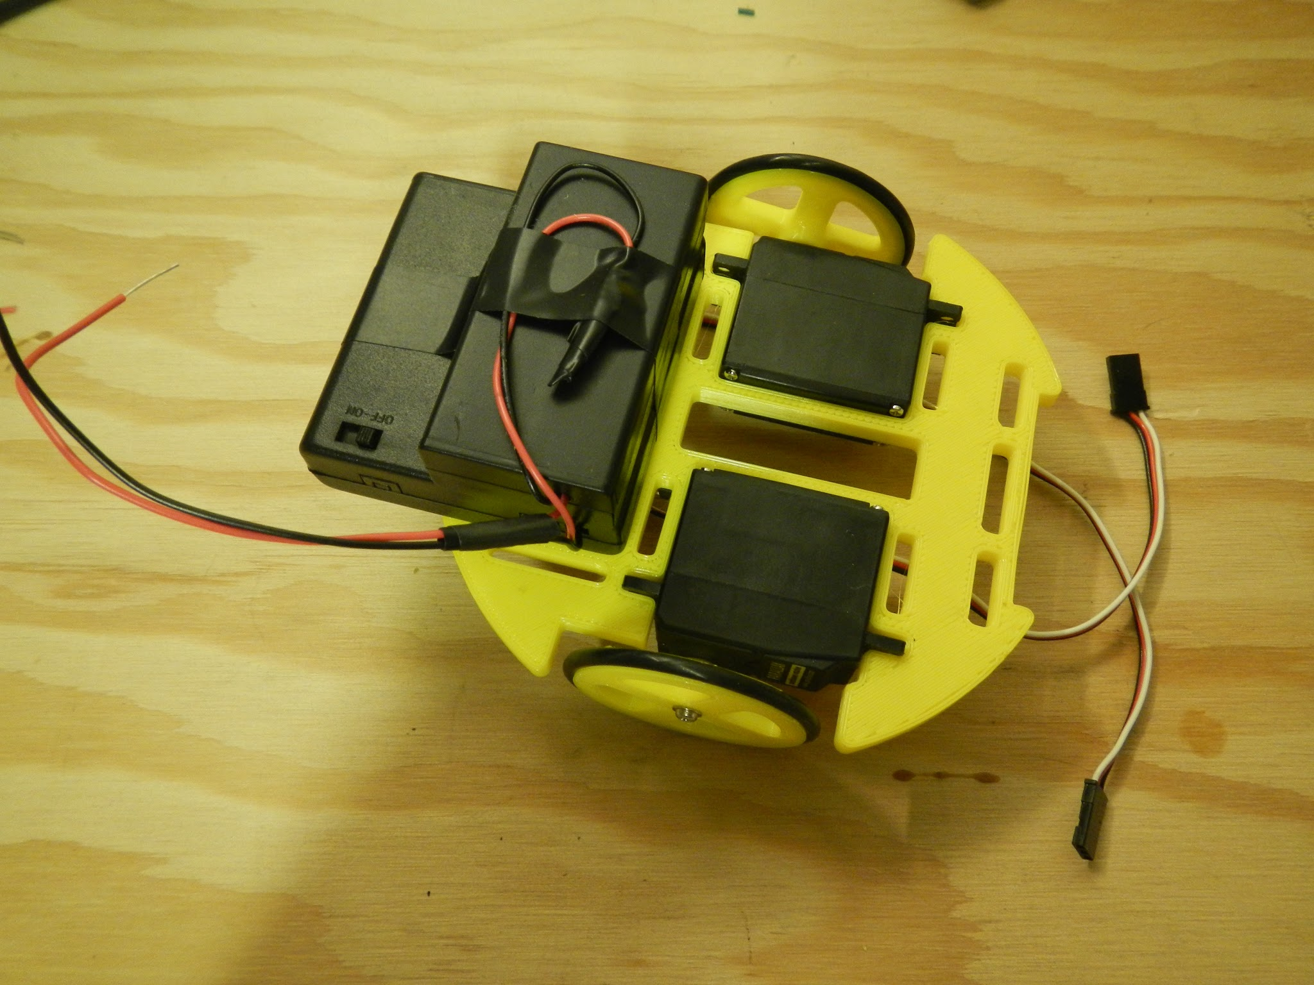
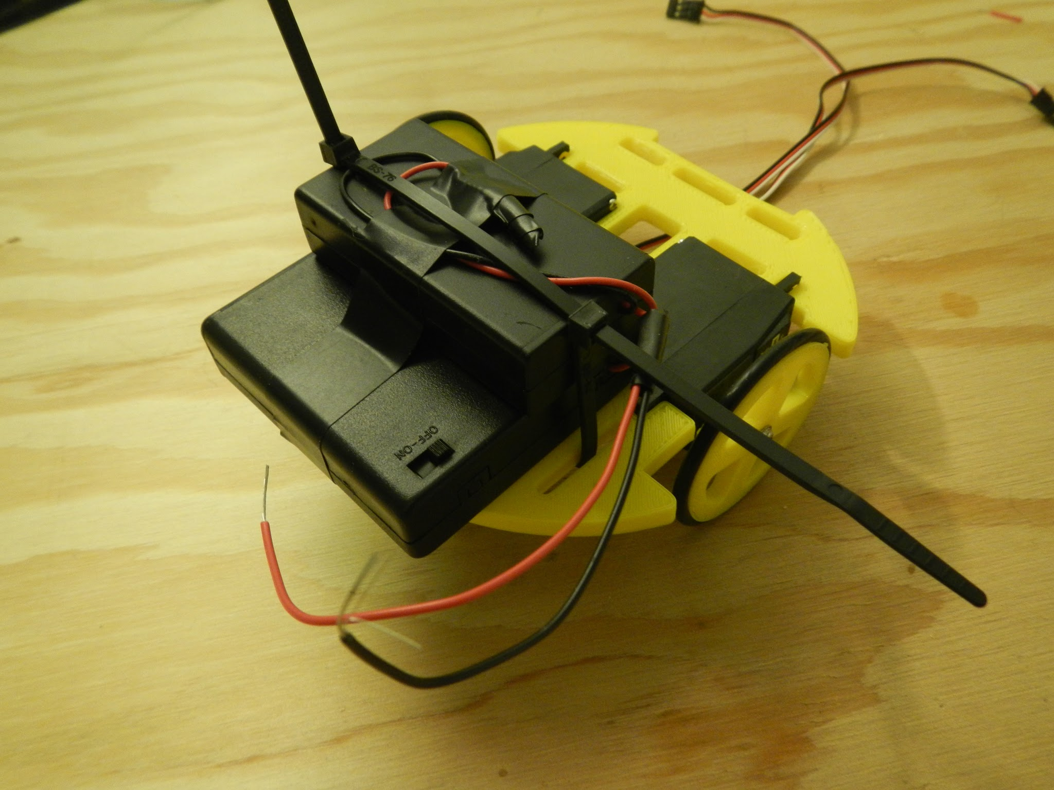
Battery pack + zip ties

Slide 28
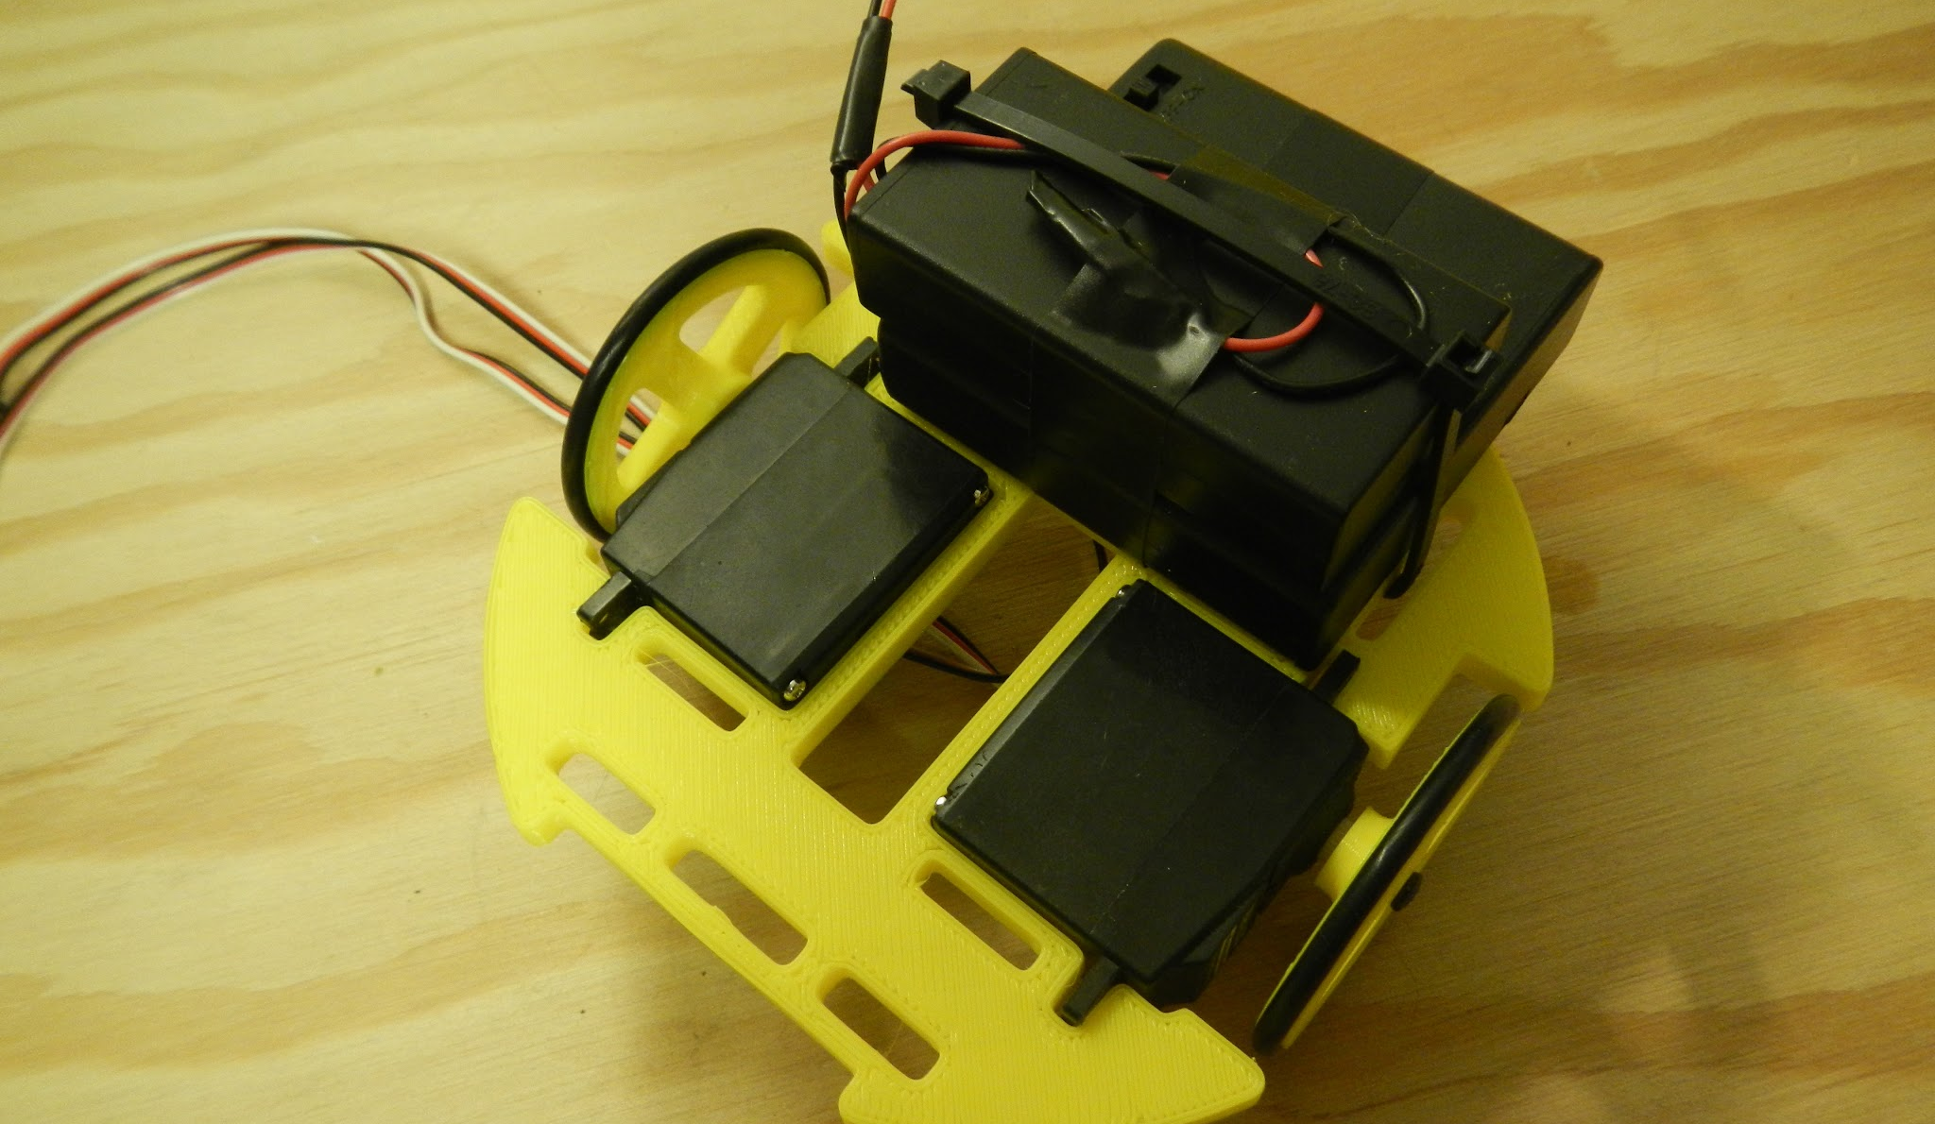
Cut zip-ties

Slide 29
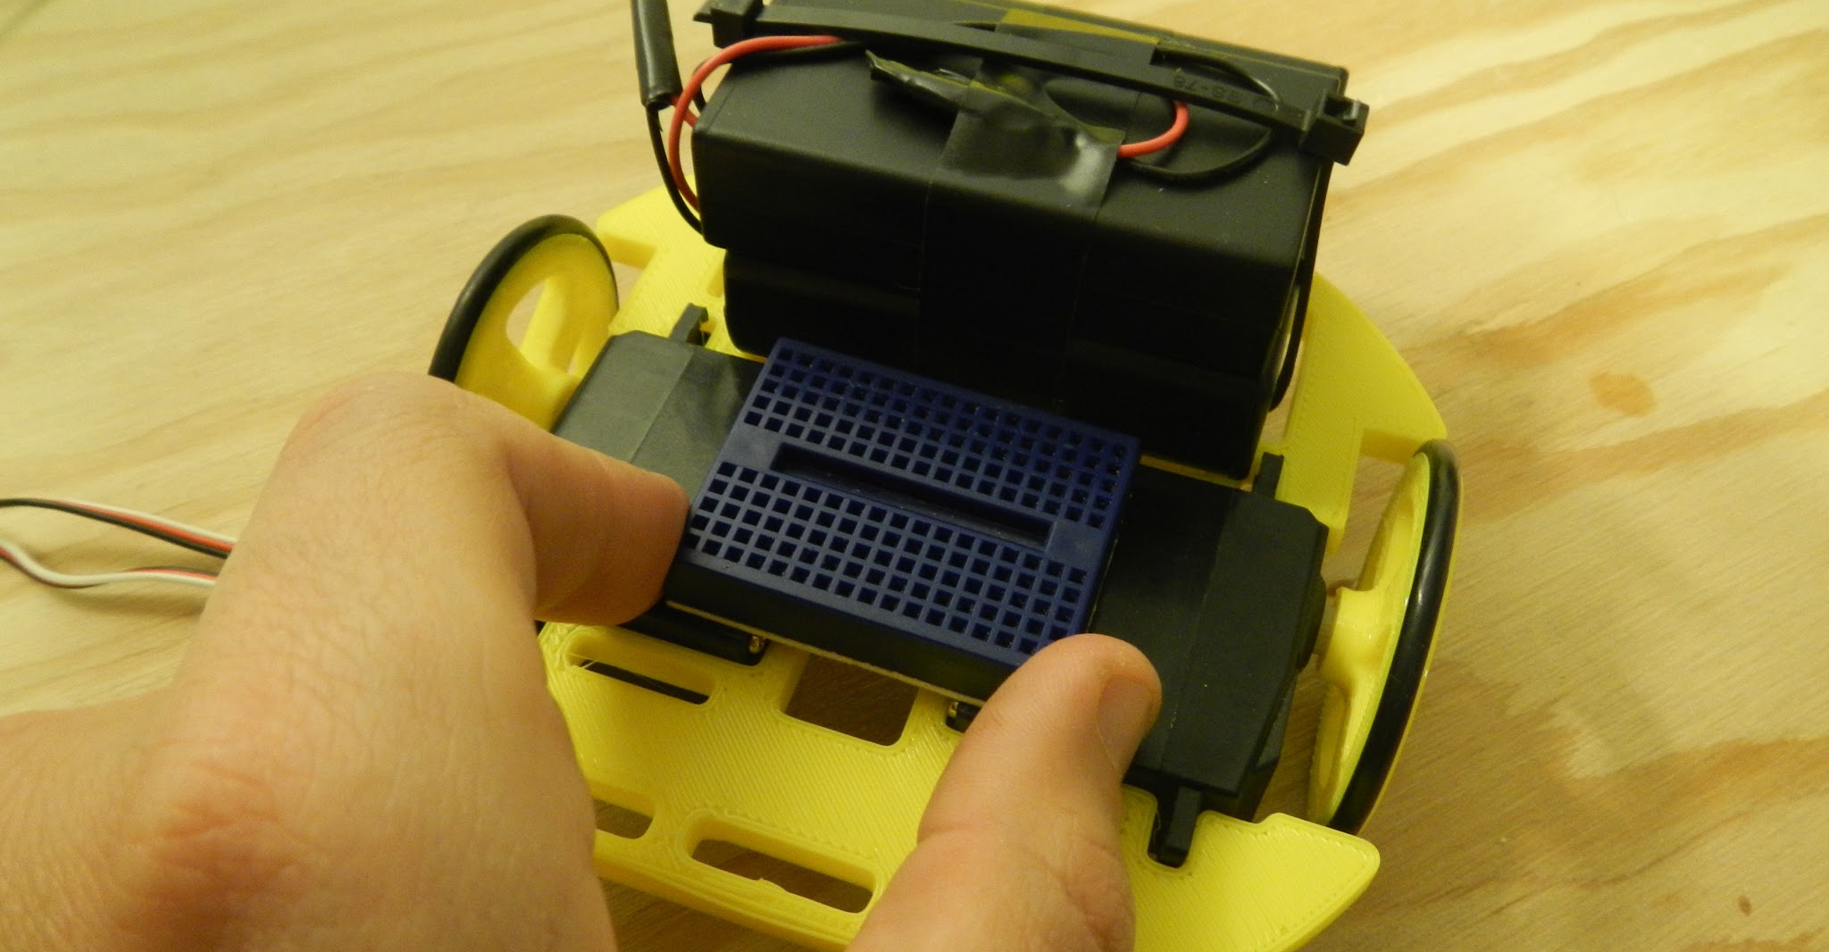
Add mini breadboard
Remove sticker from back side.

Slide 30
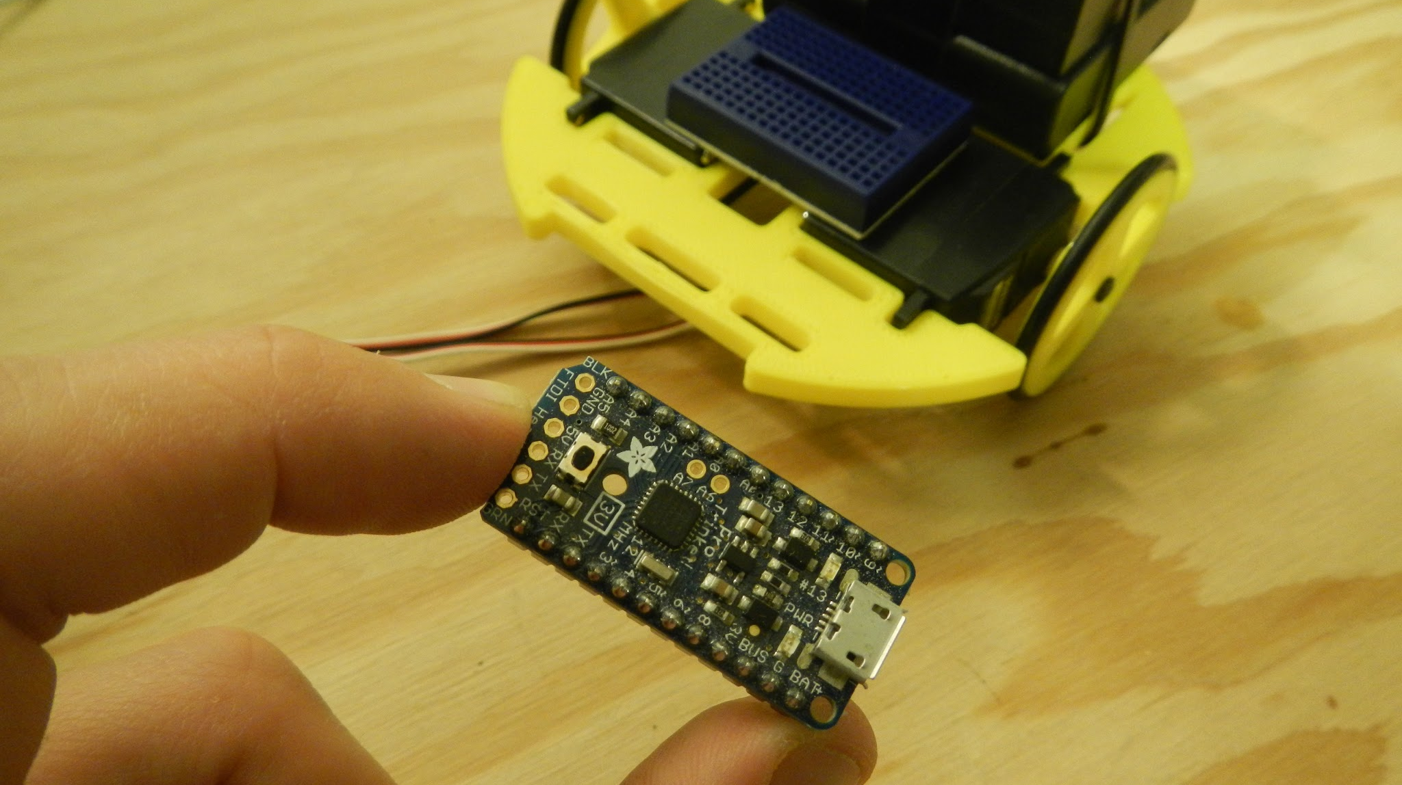
Add Arduino nano
Note: you arduino will look slightly different!

Slide 31
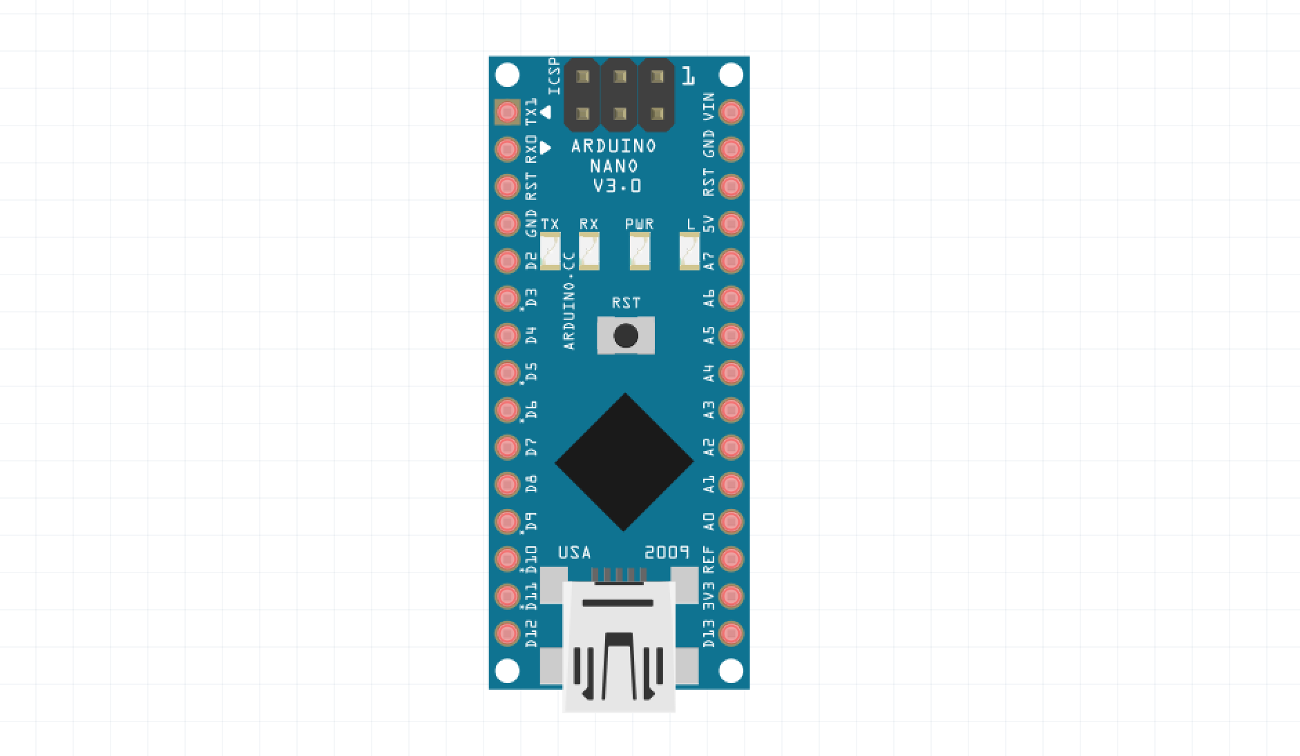
Arduino nano pins
Vin = Battery+
GND = Battery-
GND
5V+
Analog pins
Digital pins
USB Port

Slide 32
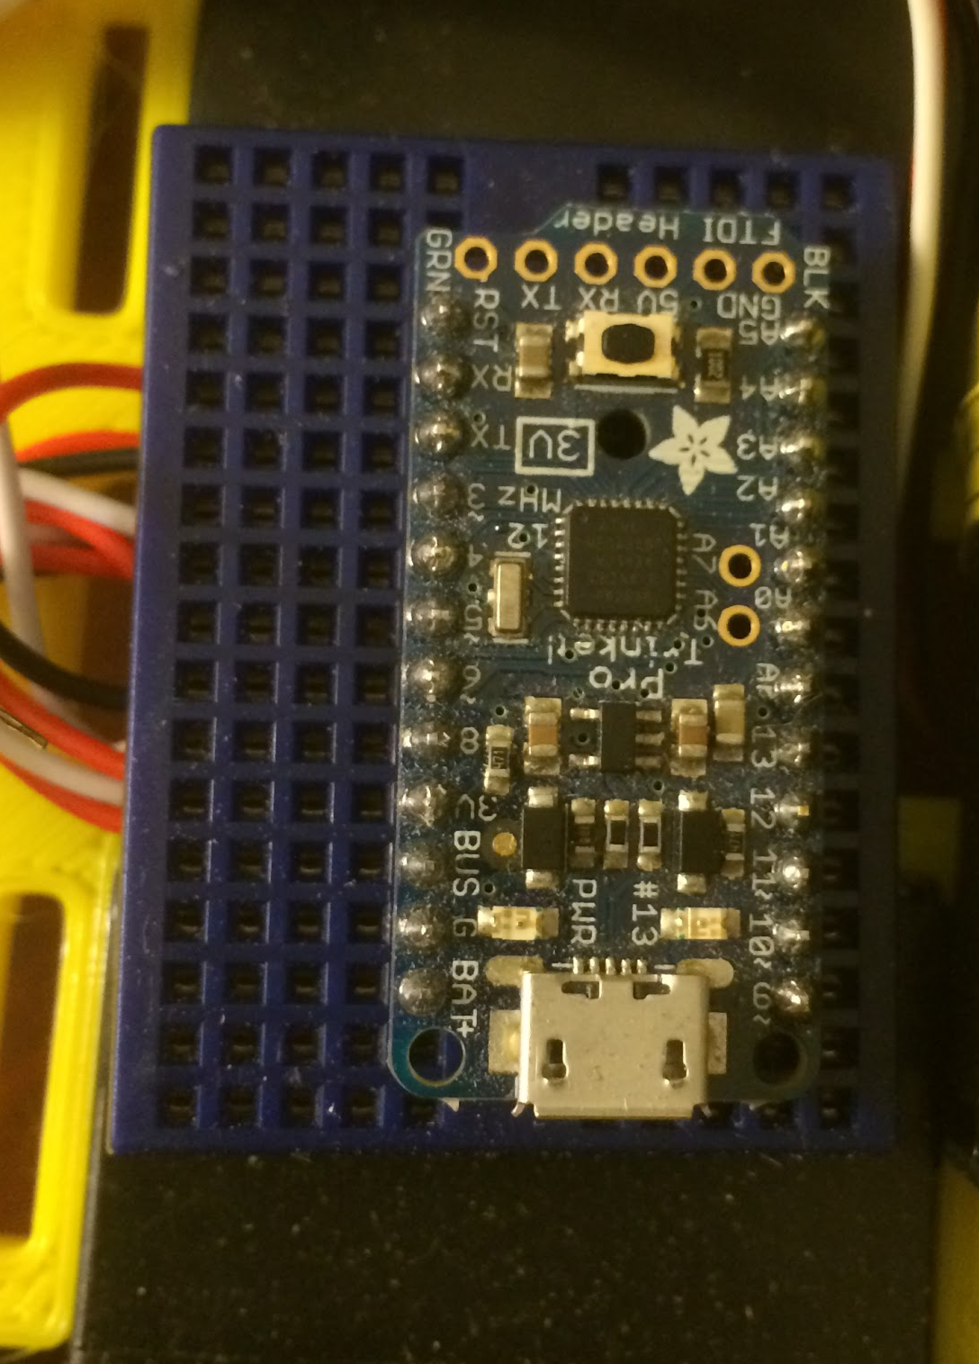
Arduino Nano
-Plug the Arduino Nano into the mini-breadboard.
-The Arduino should span the dip channel.
-Leaving 4 open pins available on the left side (digital pins).

Slide 33
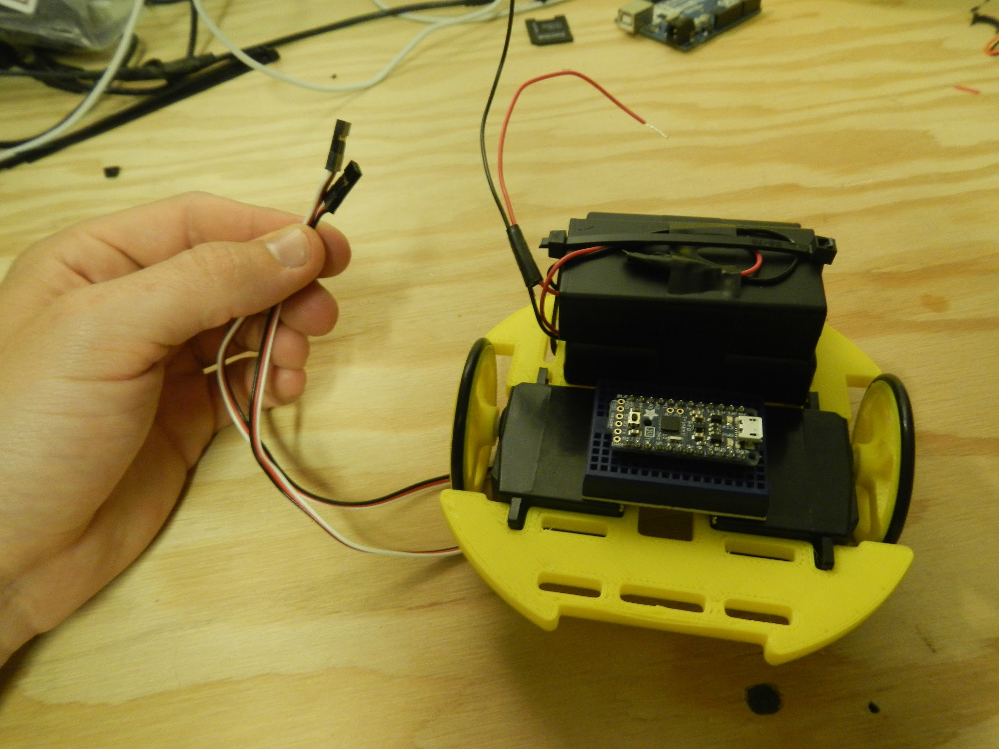
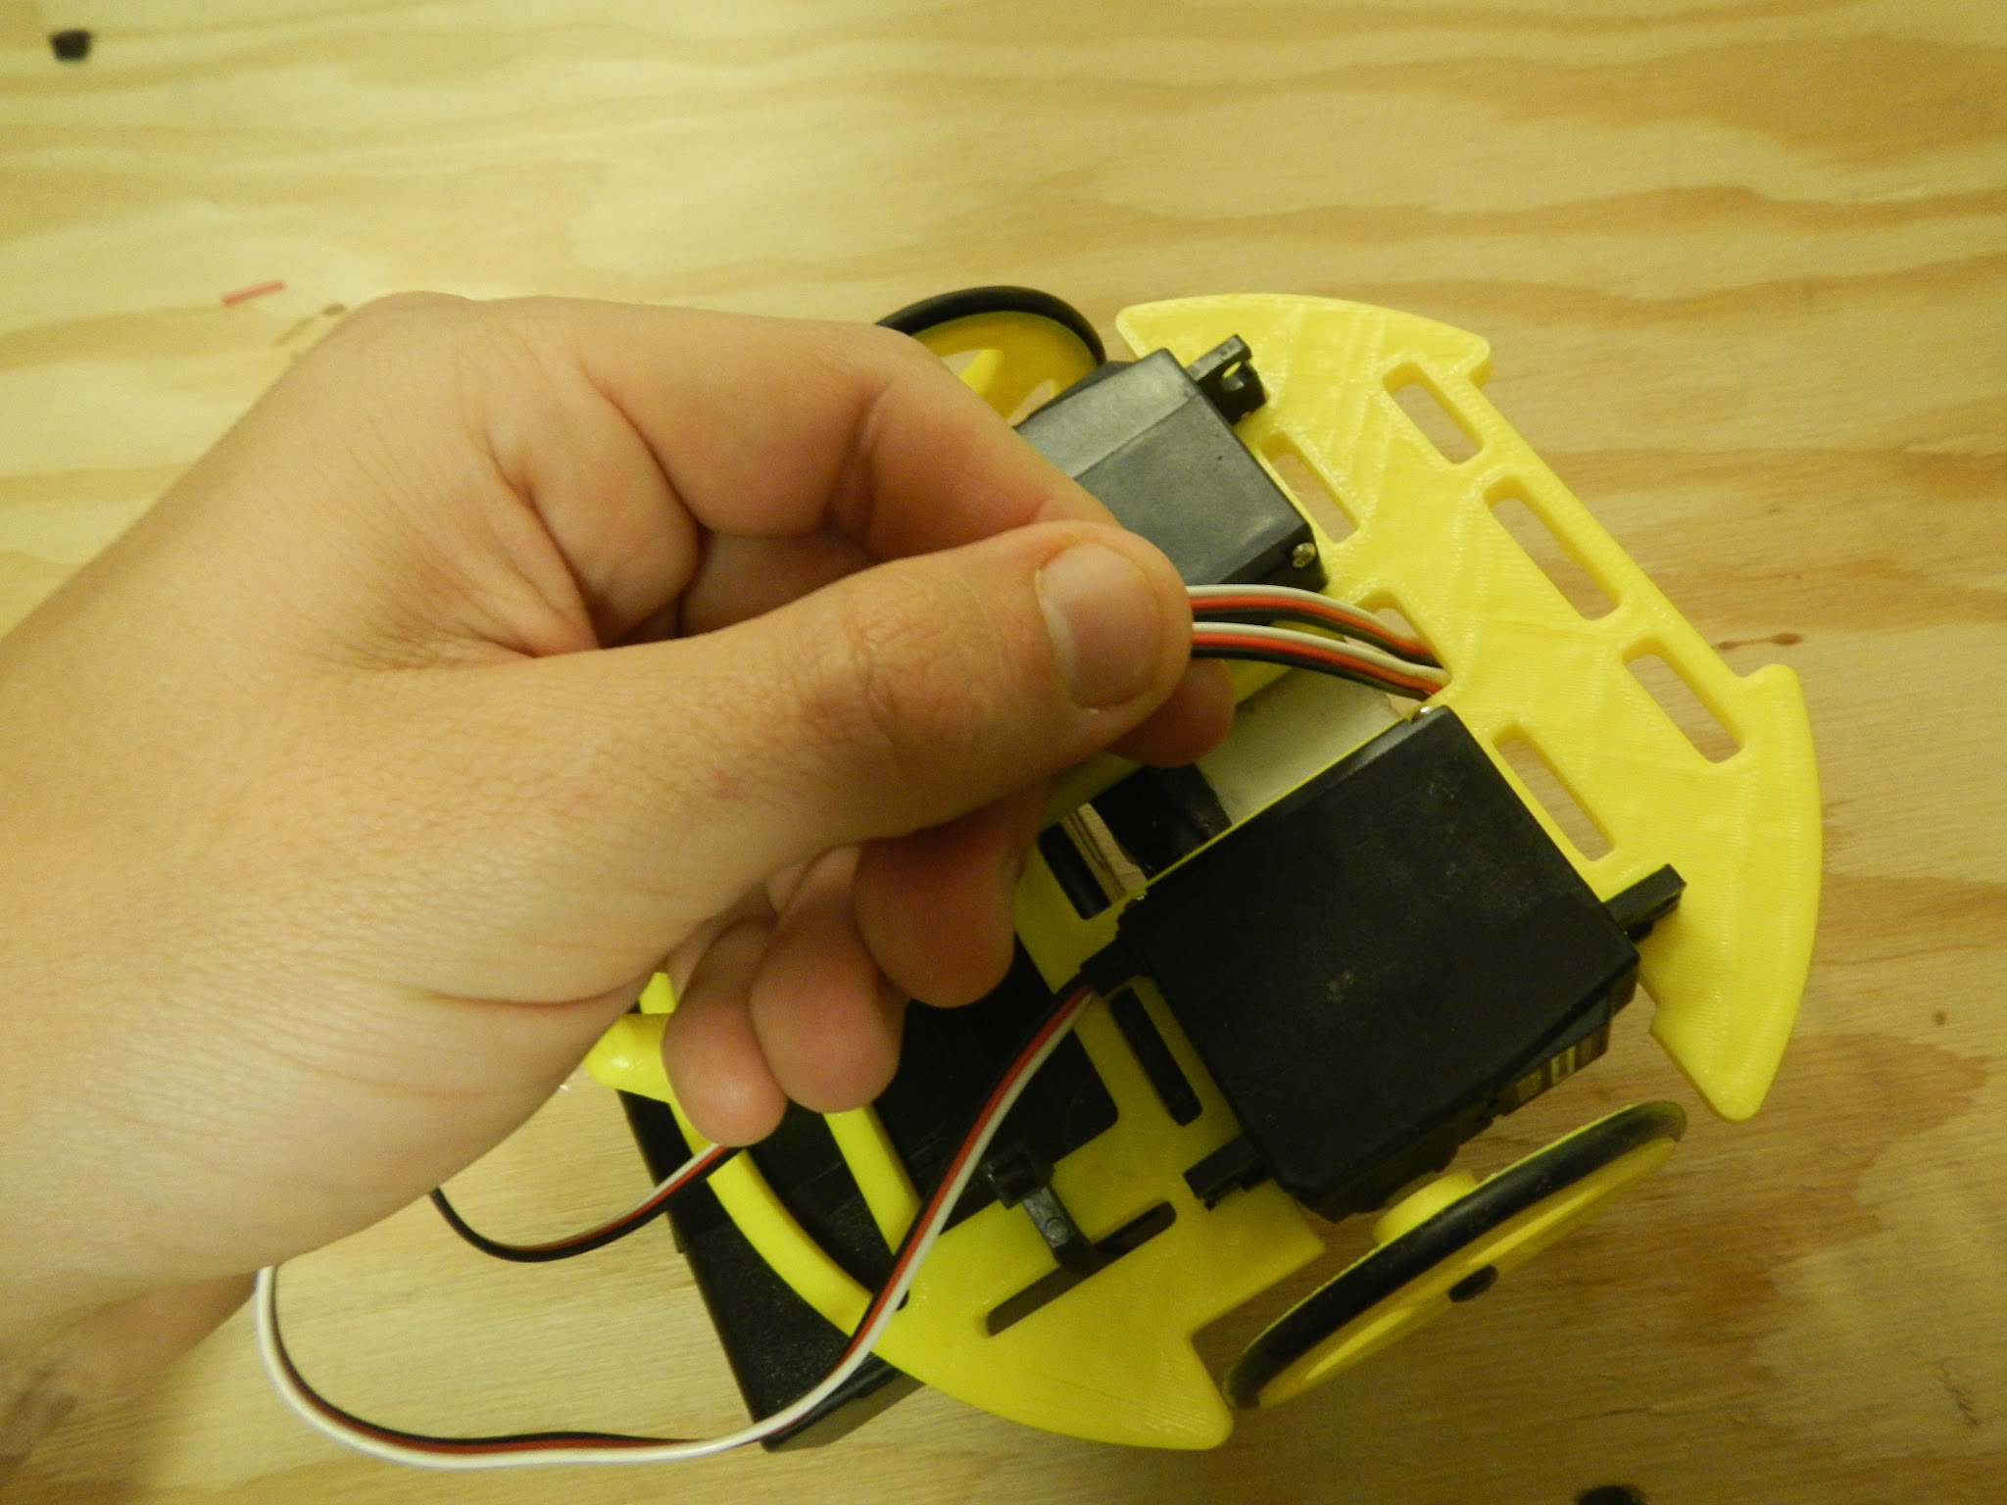
Route servo wires through chassis

Slide 34
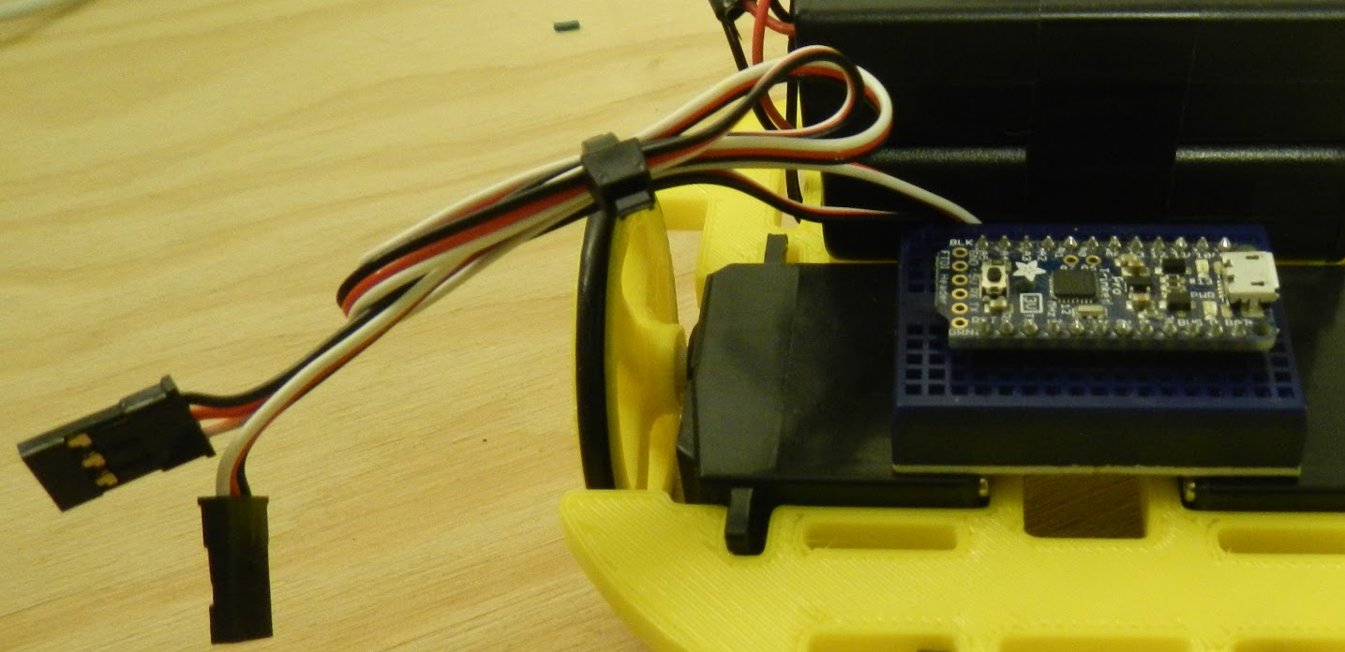
Add zip tie to servo wires

Slide 35
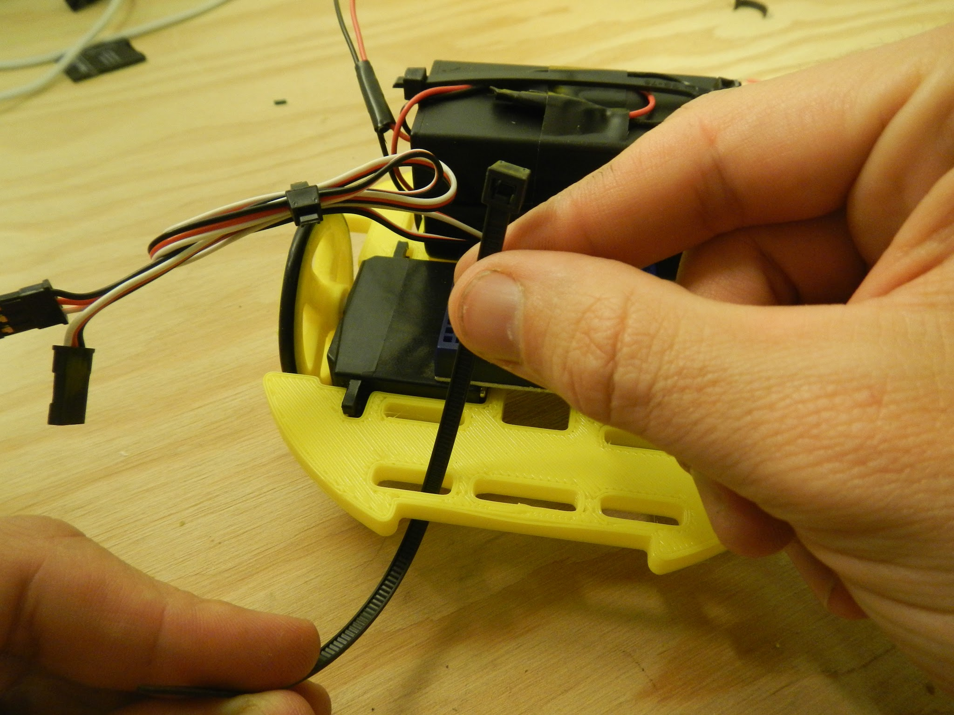
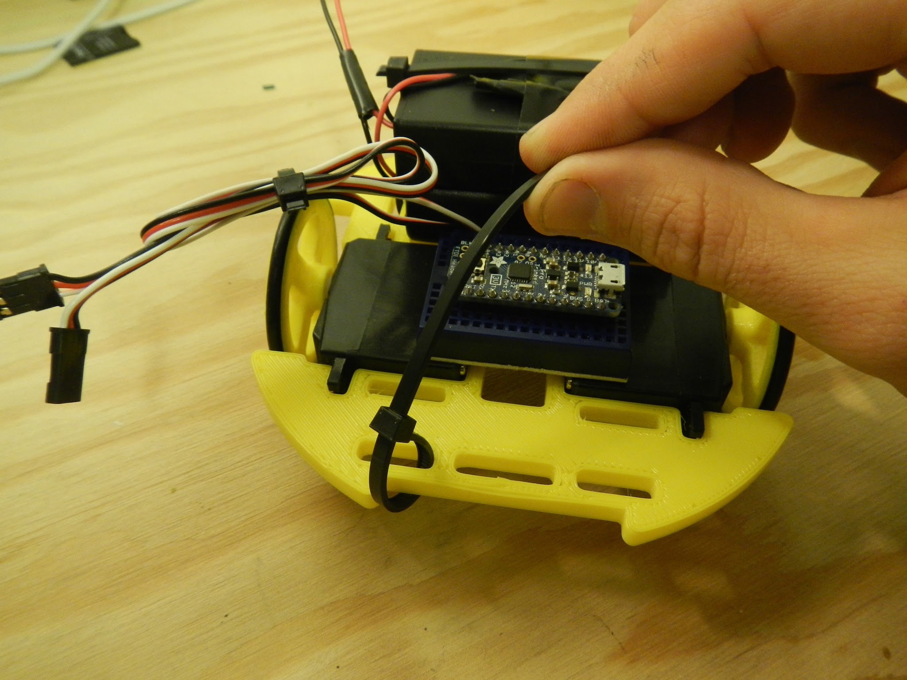
Add IR sensor zip ties

Slide 36
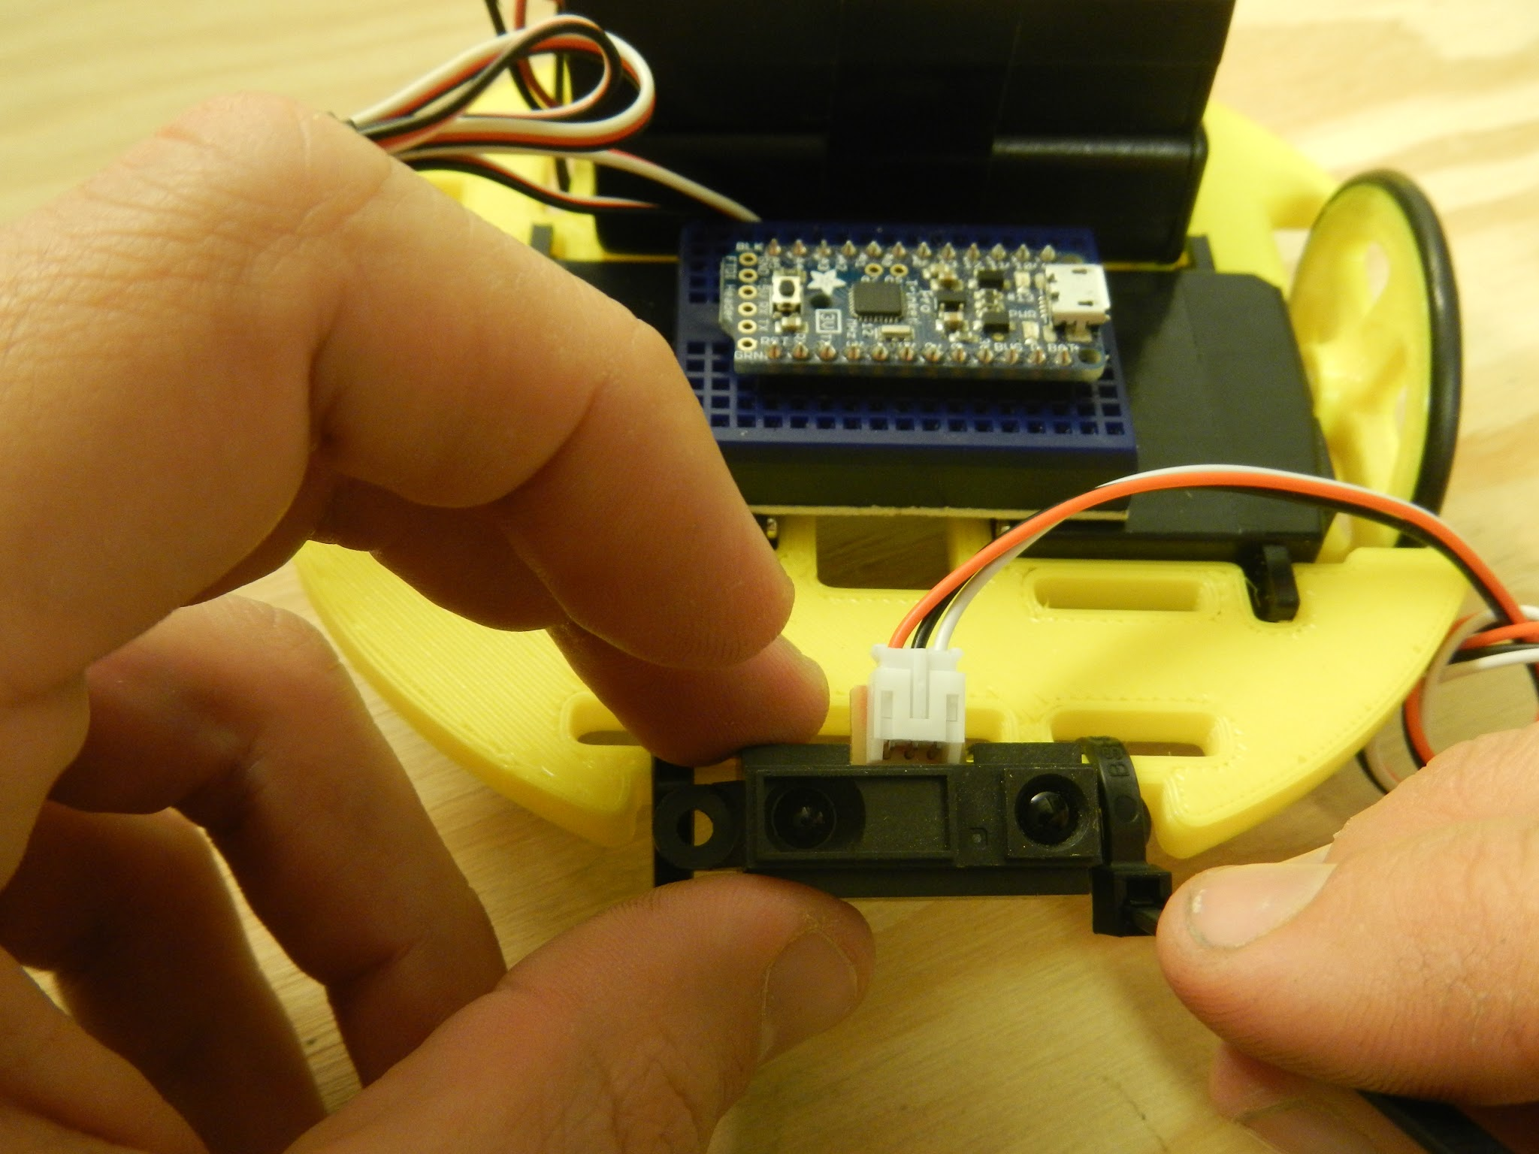
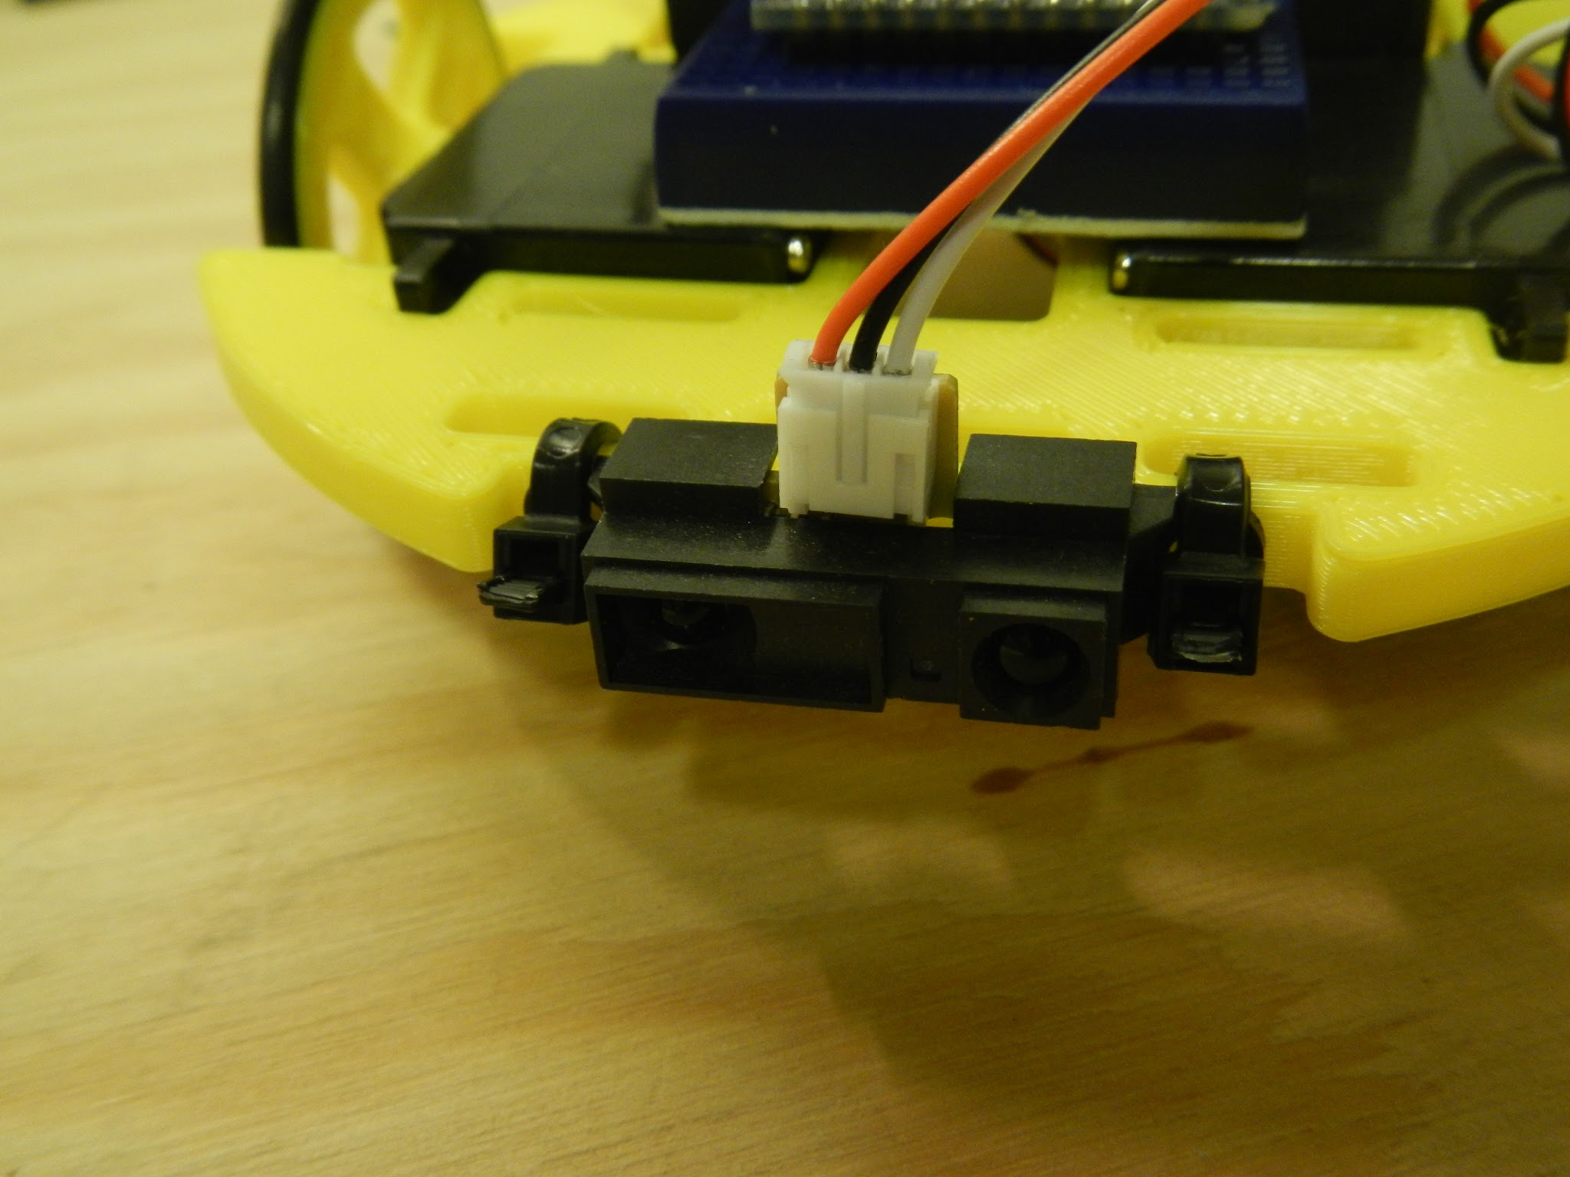
Add the IR sensor

Slide 37
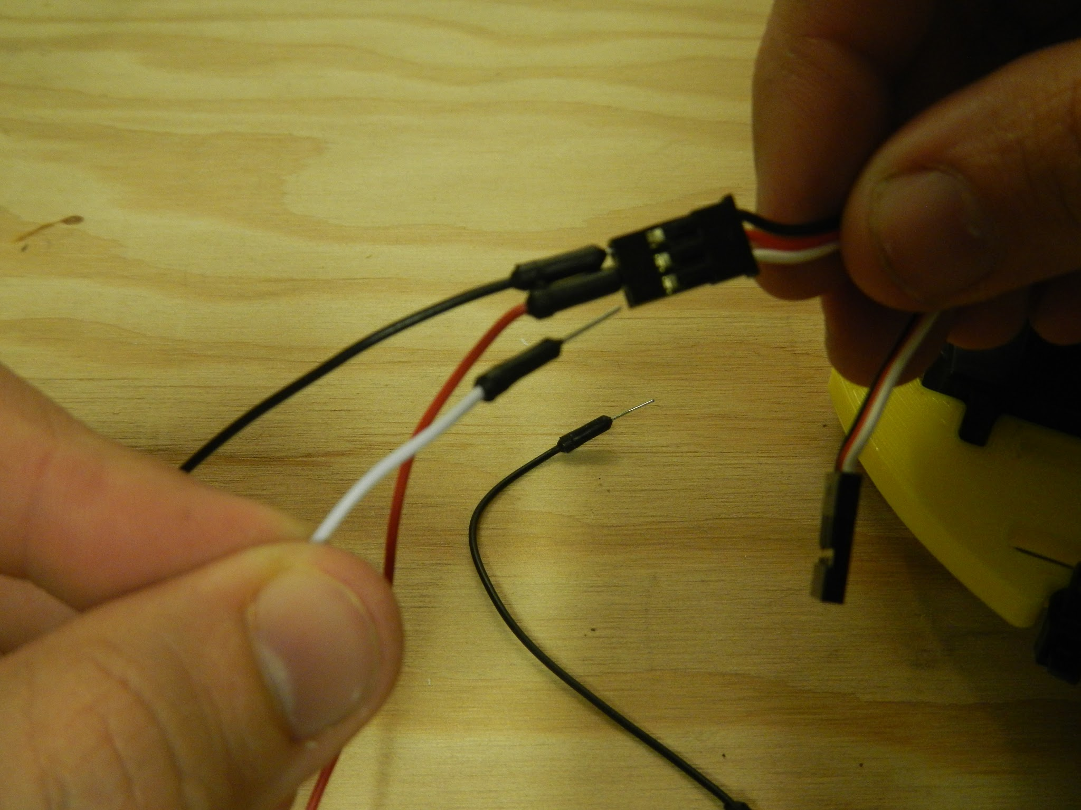
Add jumpers to servo

Slide 38
Wiring - (check is everyone ready?)

Slide 39
Wire your ServoBot

Slide 40
Arduino nano pins
Vin = Battery+
GND = Battery-
GND
5V+
Analog pins
Digital pins
USB Port

Slide 41
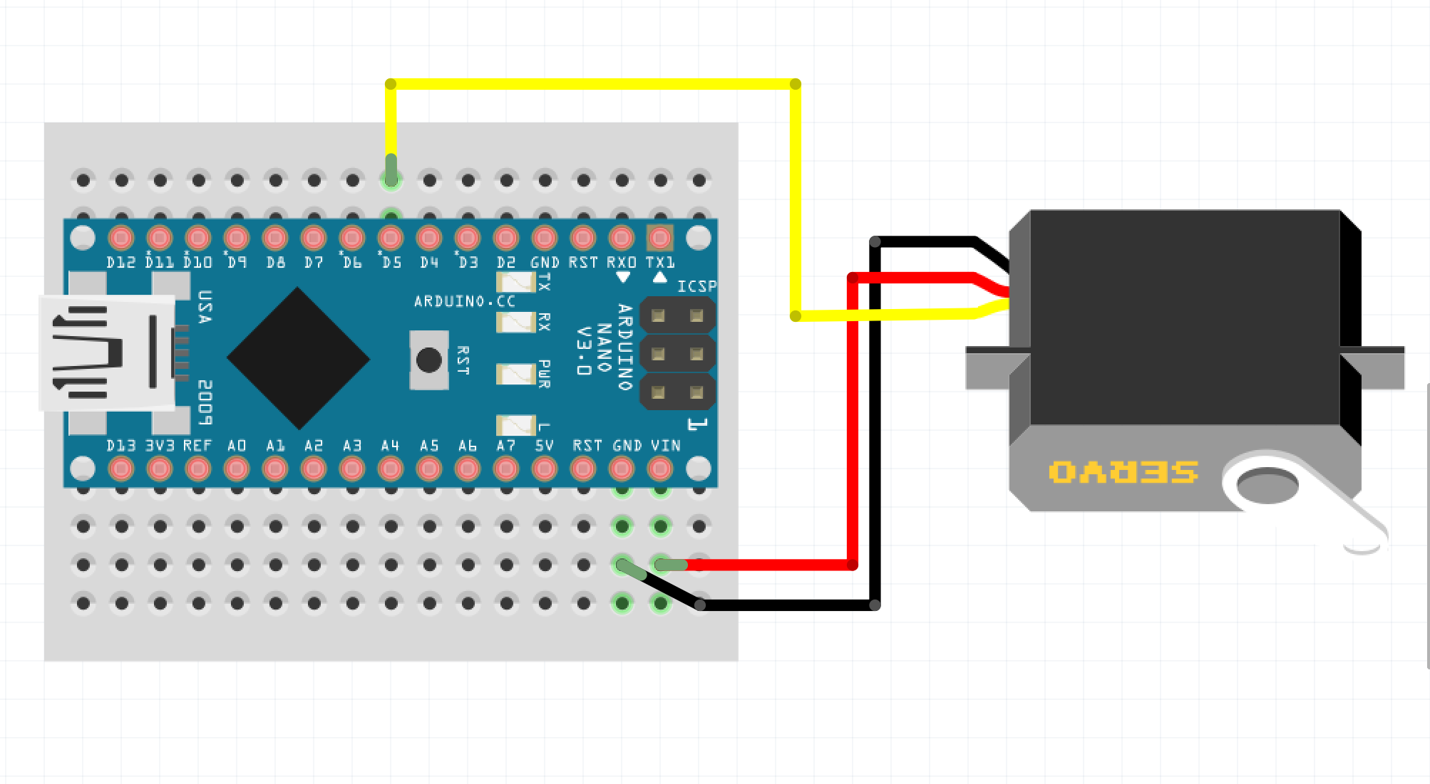
Wiring - Servo Left
LEFT
-Plug signal wire (yellow or white) into D5 on Arduino.
-Plug Red wire on servo motor into +Vin on Arduino.
-Plug Black wire on servo motor into GND on Arduino.

Slide 42

Wiring - servo right
`
RIGHT
`
`
-Plug signal wire (yellow or white) into D6 on Arduino.
-Plug Red wire on servo motor into +Vin on Arduino.
-Plug Black wire on servo motor into GND on Arduino, side with one pin.

Slide 43

Wiring - IR sensor
`
-Plug signal wire ( white) into A0.
-Plug Red wire into +5V on Arduino.
-Plug Black wire o into GND on Arduino.

Slide 44

Wiring - battery pack
-Plug red wire into Vin.
-Plug black wire into GND.

Slide 45
Scripting Basics

Slide 46
Scripting Basics
Compiler
Basic syntax
Variables
Functions
Operators
Control Structures
Predefined Functions

Slide 47

Arduino IDE
Integrated Development Environment.
Code Editor
Debugger
Compiler
Serial Monitor

Slide 48
The Compiler
//Source Code
int led = 13;
digitalWrite(led, HIGH);
What does it do?
It turns human readable code into machine readable instructions.
The compiler is part of the free Arduino Integrated Development Environment (IDE) from http://www.arduino.cc.
The IDE also includes code examples and many code libraries.
Debugger
Compiler
Arduino
10010011100100100100001010 1001001010010010100100101001001100110100111111010101001010101001000100111101010100100100100101001001001000

Slide 49
Basic Syntax
; (semicolon) | Used to end a statement. a = 1; is valid syntax b = 5 is invalid syntax
{} (curly brackets) | Brackets are opened with { and closed with }. Between the brackets will be additional lines of your code. if(true) { //Your code here }
// (single line comment) | Used put single line comments into your code. These inlines are ignored by the compiler and are not sent to the Arduino.
/* */ (multi-line comment) | Used for multi line comments in your code. Also ignored by the compiler.
#include | Includes a defined code library. #include <Servo.h>;

Slide 50
Variables
Type Cast | Name | Value
int | irSensor | 0
Assigned a value
Scope
Global
Defined at the top
Can be accessed and modified from anywhere in the script.
Local
Defined inside a function
Can only be accessed and modified from within the function.
Data types
int = integer (0,1,5,360)
char = character (a,b,c,X,Y,Z)
Example
int irSensor = 0;
char message = “Hello”;

Slide 51
Functions
Data Type | Name | Parameters | Code
int | addNumbers | (a,b) | adds numbers
Contain a set of code that can be called and reused.
Type cast based on functions propose.
Parameters may be defined but are not required.
Example
void loop()
{
int sum = addNumbers(1,2);
}
int addNumbers(a,b)
{
int answer = a+b;
return answer;
}

Slide 52
Operators
Arithmetic
= assignment
+ adds
- subtracts
* multiples
/ divides
Example a = 1 + 1;
Comparison
== equal to
!= not equal to
< less than
> greater than
<= less than equal to
>= greater than equal to
Example
if(a == b) {
}
Compound
++ increment
-- decrement
+= compound addition
-= compound subtraction
Example
a = 1;
a++;
a now equals 2
Boolean
&& and
|| or
! not
Example
if(a == 1 && b == 2)
{
//Code
}

Slide 53
Control Structures
A control structure is a block of code that chooses a direction for the application to take based on a condition.
It can use variables and operators.
Example
int a = 1;
int b = 1;
if(a == b)
{
//Run this if A and B are equal
}
else
{
//Run this if A and B are not equal
}

Slide 54
Predefined Functions
Serial
A library that provides communication from the Arduino to a computer or other device.
analogRead
Returns an input value for a specified analog pin.

Slide 55
Arduino Learning Resources
Getting Started with Arduino
Arduino Language Reference
Adafruit Learning Center

Slide 56
Programming the ServoBot

Slide 57
Step 1: Create a new Sketch

Slide 58
void setup()
{
}
void loop()
{
}
Step 1: New Sketch
Open the Arduino IDE.
Create a new Sketch with the basic Sketch requirements:
1 setup function
1 loop function

Slide 59

Step 1: Servos
90 degrees
STOP
The Servo library controls the direction of the servos by feeding them a specific degree between 0 and 180.
If the servo is sent a value of 180 it moves in one direction.
If the servo is sent a value of 0 it moves in the opposite direction.
If the servo is sent a value of 90 it doesn’t move.
0 degrees
180 degrees

Slide 60
#include <Servo.h>
Servo rightServo;
Servo leftServo;
const int rightForward = 0;
const int rightBackward = 180;
const int leftForward = 180;
const int leftBackward = 0;
const int brake = 90;
Step 1: Assign some variables
Create servo assignments. We need assignments for the left and right servos.
Set directional variables for the servos. We will need to tell each servo how to rotate forward, backwards, and stop.
Put these variables above the setup() function.

Slide 61
Step 1 Code Check

Slide 62
Step 2: Movement Functions

Slide 63
void forward()
{
rightServo.write(rightForward);
leftServo.write(leftForward);
}
Step 2:Movement functions
Create a new function that will be used for forward movement.
This forward function needs to control both left and right servos.
This will happen below the loop() function.

Slide 64
Step 2 Code Check

Slide 65
Step 3: Moving the Robot

Slide 66
void setup()
{
rightServo.attach(6);
leftServo.attach(5);
}
Step 3: Moving the Robot
We need to attach the pins to the servo objects.
This only needs to happen once in the setup function.

Slide 67
void loop()
{
forward();
}
Step 3: Moving the Robot
Now call the forward function in the main loop function.

Slide 68
Step 3 Code Check

Slide 69
Step 4: Save & Upload

Slide 70
Step 4: Save & Upload
Save and upload the code to the Arduino.
Verify the code
Upload code

Slide 71
Step 5: More movement

Slide 72
Step 5: More movement
CODE
void right()
{
rightServo.write(rightBackward);
leftServo.write(leftForward);
}
void allStop()
{
rightServo.write(brake);
leftServo.write(brake);
}
void backward()
{
rightServo.write(rightBackward);
leftServo.write(leftBackward);
}
void left()
{
rightServo.write(rightForward);
leftServo.write(leftBackward);
}
CODE

Slide 73
forward();
delay(2000);
backward();
delay(2000);
left();
delay(2000);
right();
delay(2000);
allStop();
delay(2000);
Step 5: More movement
Now we are going to tell the robot to start moving sequentially through our movement functions.
Call the movement functions inside the loop() function.
Save and upload.

Slide 74
Step 5 Code Check

Slide 75
Step 6: IR Sensor

Slide 76


Step 6: IR Sensor
Used to measure the distance of an object from robot.
Sends out a signal and then looks for reflected IR light.
3 Wires
Red = 5v
Black = Ground
White = Signal

Slide 77
const int irSensor = 0;
int range = 15;
Step 6: IR Sensor
Assign new variables for the IR sensor and range.
Set the irSensor to 0 because the sensor is on analog 0.
Set range to the distance target range you want the robot to react to a detected obstacle.
Put this above the setup() function.

Slide 78
int getRange()
{
int sensorValue = analogRead(irSensor);
float distance = 5262.1/sensorValue;
Serial.print(“Distance: ”);
Serial.print(distance);
Serial.println(“ cm”);
return distance;
}
Step 6: IR Sensor
Create a new function that will initiate the IR Sensor and return a calculated measurement.
Put this new function below the main loop() function.

Slide 79

Calibrating IR sensor
Excel - add “trendline”
(mm)

Slide 80
void setup()
{
Serial.begin(9600);
rightServo.attach(6);
leftServo.attach(5);
}
Step 6: IR Sensor
We need to initialize the Serial library to allow the Arduino to send serial communication to the computer for troubleshooting.
Add the Serial line to the setup() function.
Save and upload.

Slide 81
Step 6 Code Check

Slide 82
Step 7: Avoidance Logic

Slide 83
void loop()
{
if(getRange() <= range)
{
right();
}
else
{
forward();
}
delay(100);
}
Step 7: Avoidance Logic
Create a control structure (if/else statement) to trigger an action based on the value of the getRange() function.
Remove all other movement functions and delays from the main loop() and place the new code inside of the loop() function.

Slide 84
Step 7 Code Check

Slide 85
Servo Bot
Day 2 - Team Challenges

Slide 86
Objective - Day 2
Team challenges - get your robot through the maze
Equipment
2WD Robot
1 - USB cable
1 - Laptop
Materials
Cardboard
Tape
Scissors

Slide 87
Step 1: Recap

Slide 88
Recap from Yesterday
Declare variables
Set functions
Servo control
IR sensor
Have fun!

Slide 89
Step 2: Challenge

Slide 90

Navigation Strategies
Get the robot through the maze
Use basic functions, program logic
Strategies
Planned vs Random

Slide 91


Maze ideas
https://apps.carleton.edu/campus/shout/?story_id=204886

Slide 92



Maze ideas

Slide 93
Extra: adding sensors

Slide 94

Adding Sensors
-Detect wheel rotation
-Use two light sensors.
-Add a black and white disc to wheel hub.
-Count number of pulses to determine revolutions.

Slide 95




Color Sensors
Color sensor
Detect the color of an object
DIY - RGB LED and CsD sensor
Buy sensors (they work alot better!)

Slide 96

Remember, robots are our friends...

